Slide 1
Lessons 7 & 8: Dinosaurs & Ice Age
Unlocking the Mysteries of Genesis
DVD series by The Institute for Creation Research (ICR)
Mark Jurkovich
Centerville Community Church
Centerville, Ohio
May 2019

Slide 2
DVD Highlights
Fossil formation
  Formation is rare, most decay and/or are scavenged
  Must be rapidly buried
  Erosion will destroy the fossil once exposed
Difference between dinosaurs and lizards: legs beneath instead of splayed out (had to be to support weight of larger dinos)
Bones well designed to fit together

Slide 3
DVD Highlights
5 C’s of Dinosaurs
  Created – bone structure consistent with design
  Catastrophe – some cataclysmic event happened to wipe them out – global flood better explanation
    Fossils mixed with marine fossils
    Evidence of volcanic activity
    Large extent of fossils (not confined to river beds)
  Collagen – soft tissue found in many dinosaur bones; cannot be millions of years old
  Carbon 14 – C¹⁴ found in dino and other fossils show they are only thousands of years old; cannot be millions.
  Clashes – much recorded evidence of humans interacting with dinosaurs found in cultures around the world

Slide 4

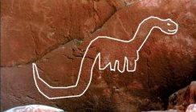
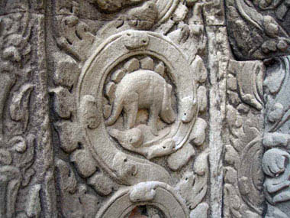
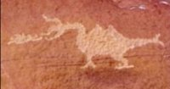
Dinosaurs and man alive at the same time
Evidences all around the world show ancient man knew about (had to have seen living) dinosaurs
Mesopotamian cylinder seal dated at 3300 BC
Natural Bridges National Monument
Middle Mesa at the Wupatki National Park
12 century temple in Cambodia

Slide 5
Dragon legends are universal
Some clearly fanciful, others (especially the older stories) are very ‘matter of fact’ and some provide descriptions matching dinosaurs
Ex. Bel and the Dragon in the Apocrypha
Ex. Beowulf describes several sea creatures, a flying creature fitting a Pterodactyl, and Grendel fits TRex (ex. short arms & huge jaw) [ref. After the Flood]

Slide 6
Summary
Fossil record clearly shows story of catastrophe
Bible describes dinosaurs
Evidence from all around the world shows dinosaurs lived after the flood
Still some alive today??
  Remotely Possible

Slide 7
Episode 8: The Ice Age

Slide 8
DVD Highlights
Problems with secular theories for an ice age
  Astronomical theory (changes in the earth’s orbital geometry) not enough by itself
  Ice core measurements – difficult to count; become indistinct deeper in the ice
    Assumes a flow model that presumes long ages (creates circular reasoning)
  Colder winters by themselves usually means less snow

Slide 9
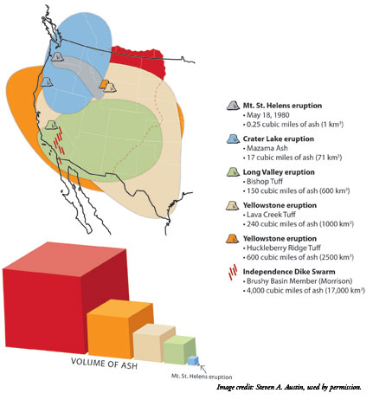
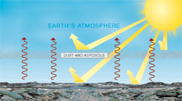
DVD Highlights
Global flood provides all the ingredients needed for an ice age
  Hot Oceans (from the fountains of the great deep)
  Evaporation (more snow in winter)
  Aerosols (from greater volcanic
  activity that continued after the
  flood) kept summers cool
  Time (but only hundreds of years,
  not tens of thousands to millions)
Less energy from sun gets through

Slide 10
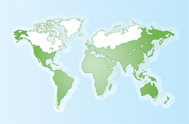
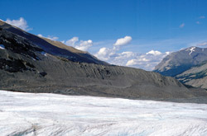
Ice Age
Ice sheets would only need 500 years to build up and 200 more to melt back off.
Land bridges during ice age key to letting man and animals repopulate the earth
“it is unnecessary to accept the current complicated evolutionary ideas of about 30 separate ice ages over the past 2.5 million years, with the most recent ones lasting 100,000 years” Michael Oard (see Ice Age article)
30% of land was covered at peak of ice age
Moraines tell us extent of glaciers
Notes:
Creation scientists have studied these implications and have come up with some key conclusions, including the following.
Note on the map these large areas in Siberia and Alaska that are NOT covered.

Slide 11
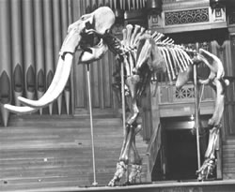
Woolly Mammoth
Mammoths likely died out at END of the ice age.
large number of bones found – probably 10s of millions lived during ice age
Large areas of Siberia and N Am glacier free – and permafrost free
Mammoths do not show evidence
of quick freezing – but…
As ice age came to end, climate
changed drastically as glaciers
melted and former northern
temperate areas got much colder
“likely died from the cold, wind, and drought that came during the deglaciation phase” (Oard, Frozen in Time)
Notes:
You cannot talk about the ice age without talking about the mammoth.
Here is what creation scientists speculate about these majestic creatures

Slide 12
Cave Man?
Not primitive - Sophisticated armaments, musical instruments and implements found with them
Babel happened while ice age was well under way, but far from the glaciated areas
Likely short duration usage as “Babel refugees” first came to new regions and ‘rode out’ the ice age
  Plenty of game, but poor climate for farming
  “Rickets is caused by a lack of vitamin D, which would be a common result of living in caves during the cloudy, bleak days of the Ice Age”
  “Life in the great Ice Age was only a blip in the life of man in Europe and western Asia.” (Michael Oard, Frozen in Time)

Slide 13
References
“Sea monsters … more than a legend?”, Creation 19(4):38–42, September 1997 http://www.answersingenesis.org/articles/cm/v19/n4/sea-monsters
ANCIENT DINOSAUR DEPICTIONS http://www.genesispark.com/genpark/ancient/ancient.htm
What Really Happened to the Dinosaurs? http://www.answersingenesis.org/articles/nab/what-happened-to-the-dinosaurs
Why Don’t We Find Human & Dinosaur Fossils Together? http://www.answersingenesis.org/articles/nab/human-and-dino-fossils-together
Australia’s Aborigines ... did they see dinosaurs? http://www.answersingenesis.org/creation/v21/i1/aborigines.asp
Human and dinosaur footprints in Turkmenistan? http://www.answersingenesis.org/creation/v18/i4/dinosaurs.asp
Dinosaur soft tissue
http://www.answersingenesis.org/docs2005/0325Dino_tissue.asp
https://answersingenesis.org/dinosaurs/bones/more-soft-tissue-in-old-fossils/
https://answersingenesis.org/dinosaurs/bones/preservation-dinosaur-protein-fragments-evolution-millions-years/
Photogallery of the Dinosaur Figurines http://www.bible.ca/tracks/tracks-acambaro-dinos.htm
Ken Ham, The Great Dinosaur Mystery Solved!, Master Books, 1998
Duane Gish, Dinosaurs by Design, Master Books, 1992
Bill Cooper, After the Flood, New Wine Press, 1995 (Beowulf stories)
Michael Oard, “Setting the Stage for an Ice Age” http://www.answersingenesis.org/articles/am/v2/n2/setting-stage-for-ice-age
Michael Oard, Frozen in Time, Master Books, 2004 http://www.answersingenesis.org/home/area/FIT/index.asp
https://www.icr.org/article/supervolcanoes-mount-st-helens-eruption

Slide 14
Supplemental info

Slide 15
Dinosaurs
Job 40:15-24
"Look at the behemoth, which I made along with you and which feeds on grass like an ox. What strength he has in his loins, what power in the muscles of his belly! His tail sways like a cedar; the sinews of his thighs are close-knit. His bones are tubes of bronze, his limbs like rods of iron. He ranks first among the works of God, yet his Maker can approach him with his sword. The hills bring him their produce, and all the wild animals play nearby. Under the lotus plants he lies, hidden among the reeds in the marsh. The lotuses conceal him in their shadow; the poplars by the stream surround him. When the river rages, he is not alarmed; he is secure, though the Jordan should surge against his mouth. Can anyone capture him by the eyes, or trap him and pierce his nose?
Notes:
No animal alive today fits this description, especially the “tail sways like a cedar” description.
It is describing a sauropod (brontosaurs, Apatosaurus , Brachiosaurus,…)

Slide 16
Leviathan
?
Job 41:1-17
"Can you pull in the leviathan with a fishhook or tie down his tongue with a rope? Can you put a cord through his nose or pierce his jaw with a hook? Will he keep begging you for mercy? Will he speak to you with gentle words? Will he make an agreement with you for you to take him as your slave for life? Can you make a pet of him like a bird or put him on a leash for your girls? Will traders barter for him? Will they divide him up among the merchants? Can you fill his hide with harpoons or his head with fishing spears? If you lay a hand on him, you will remember the struggle and never do it again! Any hope of subduing him is false; the mere sight of him is overpowering. No one is fierce enough to rouse him. Who then is able to stand against me? Who has a claim against me that I must pay? Everything under heaven belongs to me. "I will not fail to speak of his limbs, his strength and his graceful form.
Who can strip off his outer coat? Who would approach him with a bridle? Who dares open the doors of his mouth, ringed about with his fearsome teeth? His back has rows of shields tightly sealed together; each is so close to the next that no air can pass between. They are joined fast to one another; they cling together and cannot be parted.

Slide 17
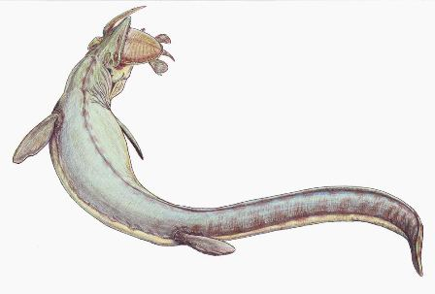
Leviathan, continued
?
Job 41:18-34
(wikipedia: Mosasaur)
His snorting throws out flashes of light; his eyes are like the rays of dawn. Firebrands stream from his mouth; sparks of fire shoot out. Smoke pours from his nostrils as from a boiling pot over a fire of reeds. His breath sets coals ablaze, and flames dart from his mouth. Strength resides in his neck; dismay goes before him. The folds of his flesh are tightly joined; they are firm and immovable. His chest is hard as rock, hard as a lower millstone. When he rises up, the mighty are terrified; they retreat before his thrashing. The sword that reaches him has no effect, nor does the spear or the dart or the javelin. Iron he treats like straw and bronze like rotten wood. Arrows do not make him flee; slingstones are like chaff to him. A club seems to him but a piece of straw; he laughs at the rattling of the lance. His undersides are jagged potsherds, leaving a trail in the mud like a threshing sledge. He makes the depths churn like a boiling caldron and stirs up the sea like a pot of ointment. Behind him he leaves a glistening wake; one would think the deep had white hair. Nothing on earth is his equal — a creature without fear. He looks down on all that are haughty; he is king over all that are proud."

Slide 18
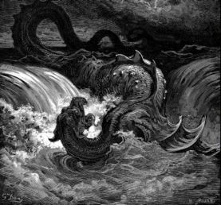
More leviathan
("Destruction of Leviathan". 1865 engraving by Gustave Doré. wikipedia )
Psalm 74:13-14
It was you who split open the sea by your
power; you broke the heads of the monster
in the waters. It was you who crushed the heads of Leviathan and gave him as food to the creatures of the desert. (result of the flood?)
Psalm 104:25-27
There is the sea, vast and spacious, teeming with creatures beyond number — living things both large and small. There the ships go to and fro, and the leviathan, which you formed to frolic there. These all look to you to give them their food at the proper time.
Isaiah 27:1
In that day, the LORD will punish with his sword, his fierce, great and powerful sword, Leviathan the gliding serpent, Leviathan the coiling serpent; he will slay the monster of the sea.

Slide 19
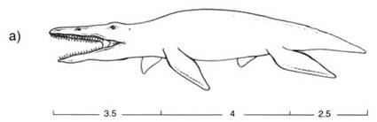
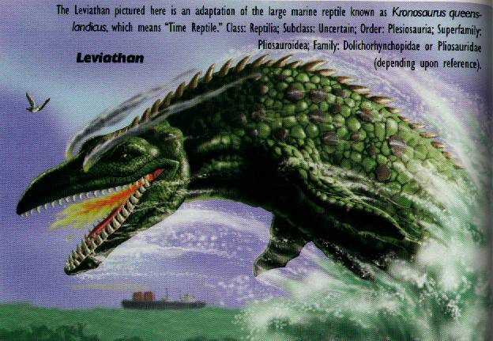
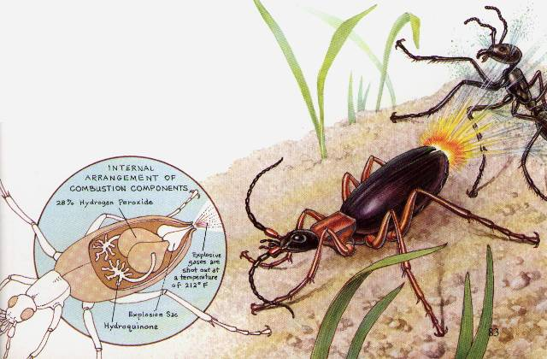
Most likely leviathan?
A Kronosaurus
Breathed fire?
(Job 41:18-21)
Bombardier beetle
(from The Great Dinosaur Mystery Solved!)
(from Dinosaurs by Design)
Notes:
The bombardier beetle is a real life example that a “fire breathing” creature as described in Job is indeed plausible.

Slide 20
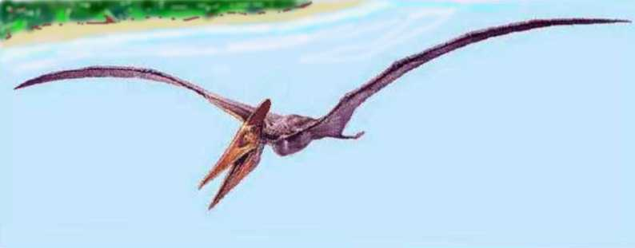
Pteranodon?
(http://www.oceansofkansas.com/Pteranodon.html)
Isaiah 14:29 (NASB)
Do not rejoice, O Philistia, all of you, because the rod that struck you is broken; for from the serpent's root a viper will come out, and its fruit will be a flying serpent. (NIV gives a less literal translation of ‘darting snakes’)
Isaiah 30:6-7
The oracle concerning the beasts of the Negev
Through a land of distress and anguish,
From where come lioness and lion, viper and flying serpent,
They carry their riches on the backs of young donkeys
And their treasures on camels' humps,
To a people who cannot profit them;

Slide 21
Supplemental Info
Dinosaur eggs laid on the run
  In a row instead of desired circle
  Others laid as the sediment was rising!
  Hadrosaur nests usually found in clumps (as opposed to a circle)
  Partially developed embryos suggests mother held it until could hold it no longer
Fossil clams buried alive (often closed, and found all over the world) and tumbled (not in upright/ anchored position)
Global sedimentary layers (ex. Austin Chalk limestone), most parallel (ex. Grand Canyon)
Therapod (meat-eating dino) foot prints in ‘wrong’ layer (Cambrian rock)
Dinosaur National Park most common fossils are clams, not dinosaurs
Hadrosaur (duck bill dinos)

Slide 22
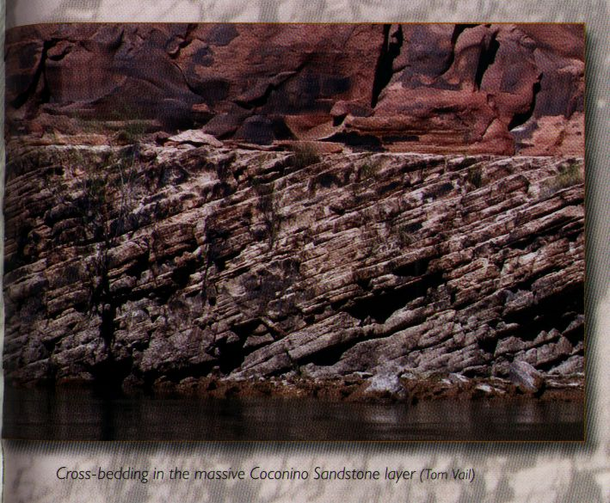
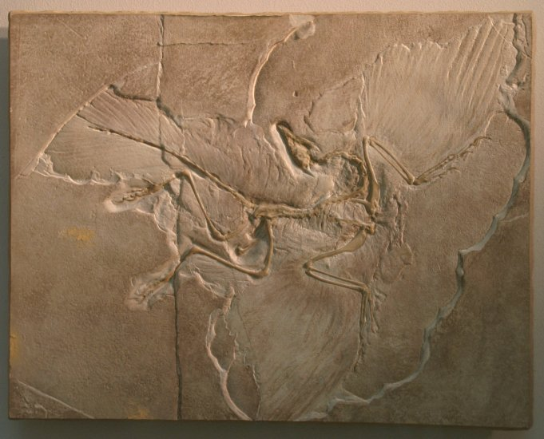
Supplemental Info
Fossils found either ‘disarticulated’ or in the ‘death pose’
Experiments show cross bedding made by water, not from sand dunes
  Unusual fossil footprints on cross beds, going up hill and fade in few feet (as water got deeper)

Slide 23
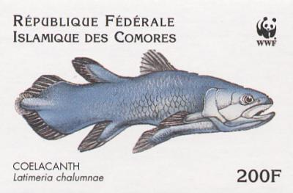
Other dino info
Dinosaur blood cells, soft, fibrous tissue, and complete blood vessels found
Only 2/3 of ‘Sue’ is fossilized (TRex in Chicago museum)
Prudhoe Bay bones frozen in tundra so fresh the sled dogs had to be kept away from them
Dino bones carbon dated when ‘should be no Carbon 14 left’
Fish thought extinct 360 million years ago found alive in 1930’s

Slide 24
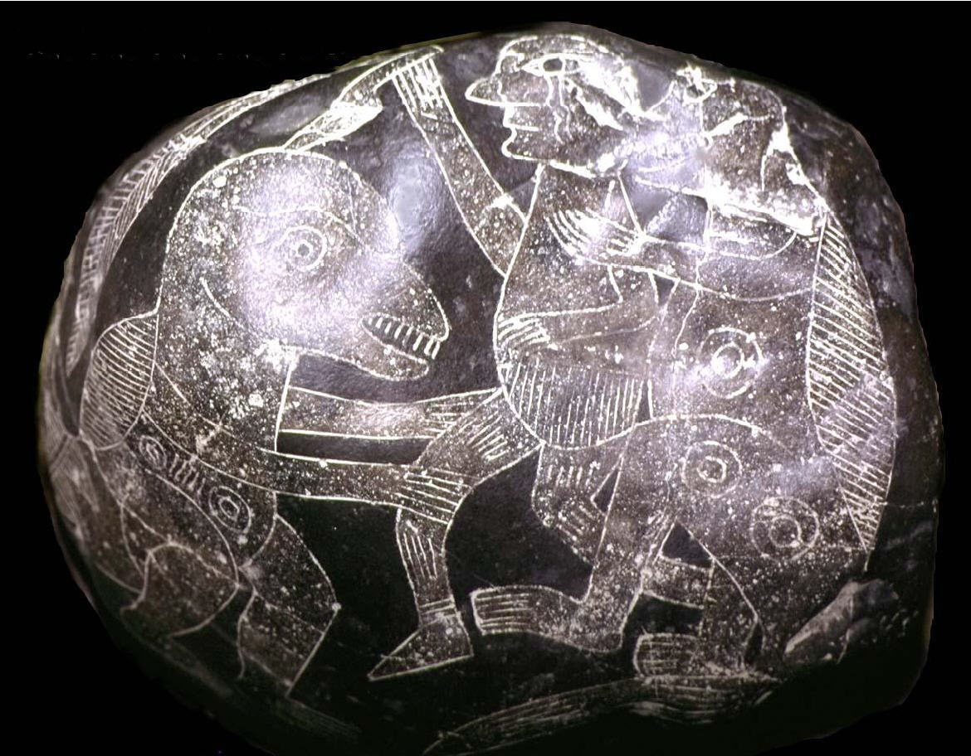
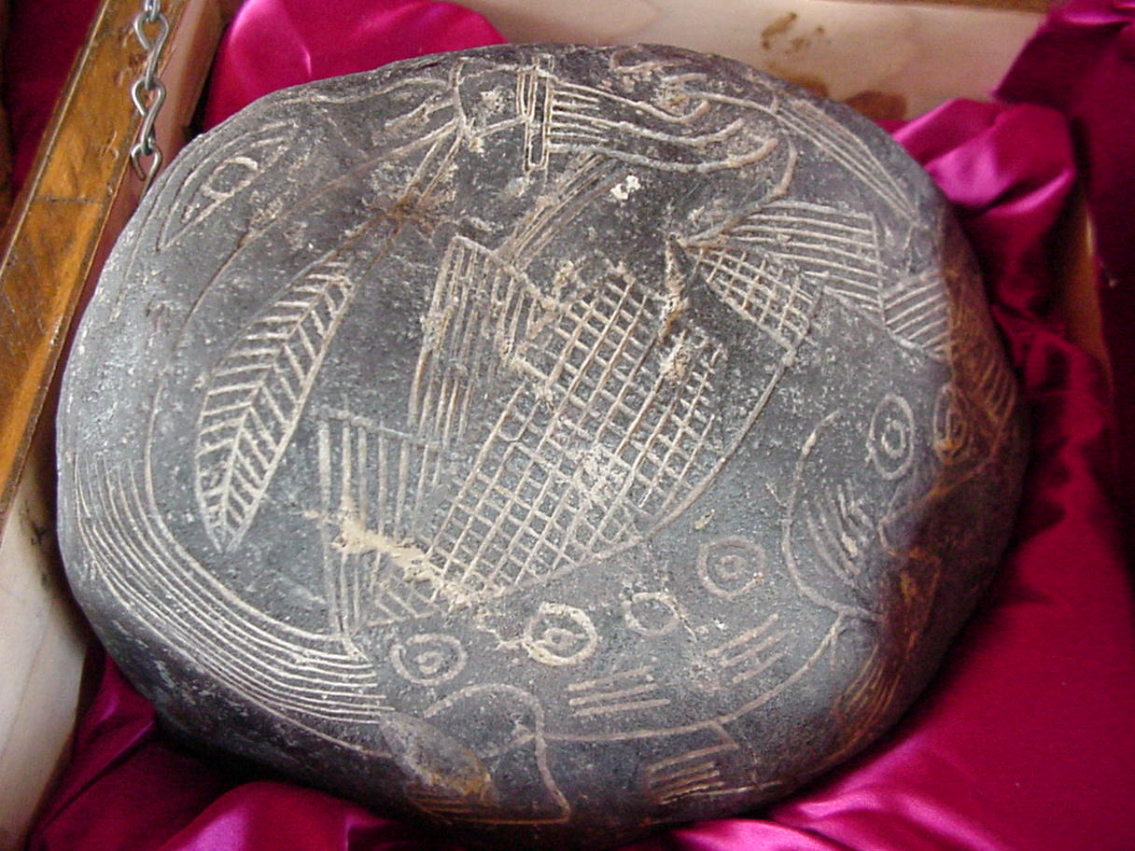
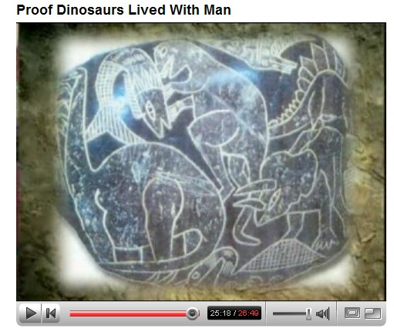
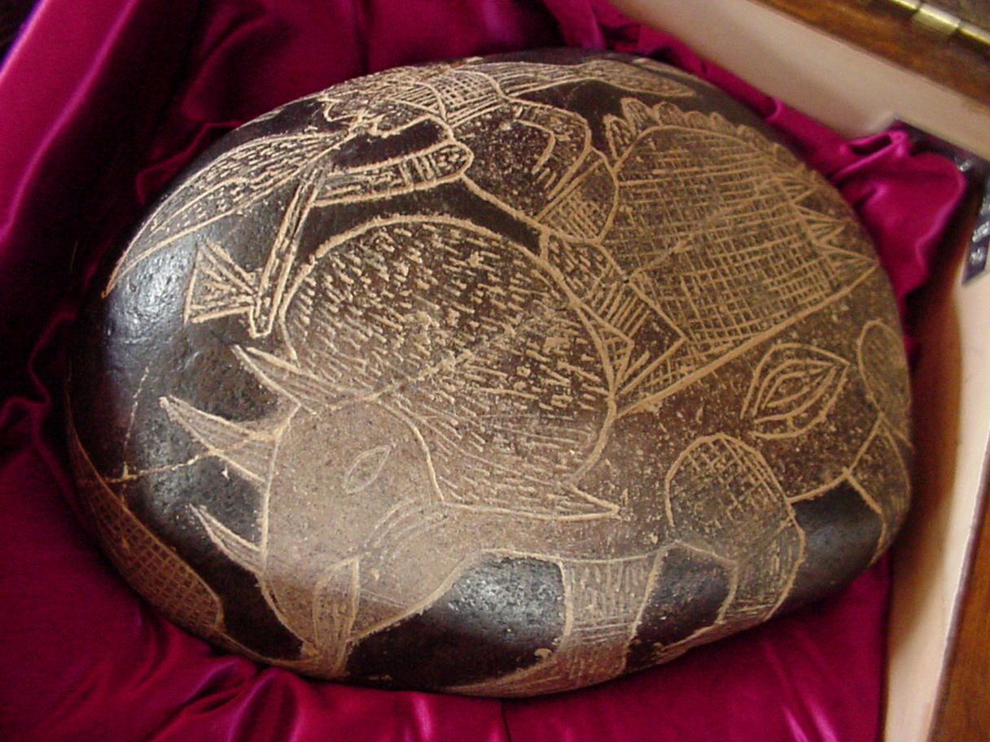
Stones of Ica Peru
Discovered 1571 by Spanish conquistadors
Other stones show people doing brain and heart surgery!
Authenticity of some disputed.
Notes:
Stones depict people fighting , feeding and even riding dinosaurs!

Slide 25
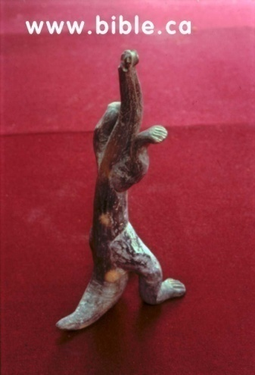
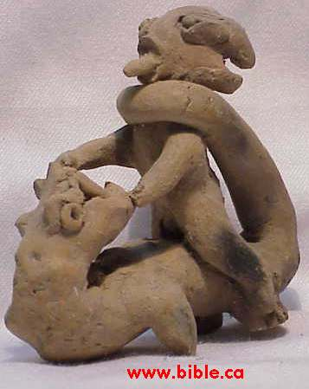
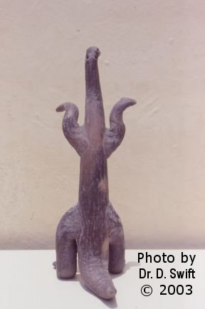
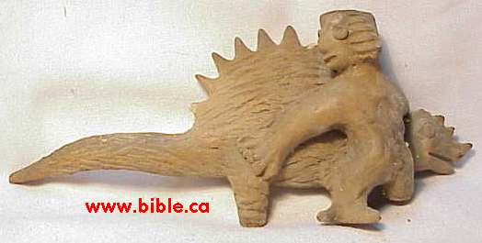
Mexico figurines
At least 2600 dino figurines found in Acambaro, Mexico.
From the Chupicauro culture, dating from 800 BC to 200 AD
(authenticity needs verification)

Slide 26
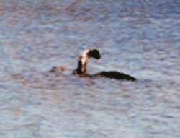
Modern sightings?
Champ of Lake Champlain
Loch Ness only one of at least 50 lakes around the world with sightings
Mokele-mbembe sauropod of Congo well known to the natives
Pterosaur sightings in Central America, Africa, New Guinea, even USA
TRex type Burrunjor of the Outback
Many credible eye witnesses, (as well as hoaxes) but until hard evidence is brought back, the world will not believe

