Slide 1
Lessons 4 & 5
Buried Clues &
Flood or Fiction
Unlocking the Mysteries of Genesis
DVD series by The Institute for Creation Research (ICR)
Mark Jurkovich
Centerville Community Church
Centerville, Ohio
May 2019

Slide 2
What the Bible says
Genesis 7
4 “Seven days from now I will send rain on the earth for forty days and forty nights, and I will wipe from the face of the earth every living creature I have made."
11-12 In the six hundredth year of Noah's life, on the seventeenth day of the second month—on that day all the springs (fountains) of the great deep burst forth, and the floodgates of the heavens were opened. And rain fell on the earth forty days and forty nights.
17-20 For forty days the flood kept coming on the earth, and as the waters increased they lifted the ark high above the earth. The waters rose and increased greatly on the earth, and the ark floated on the surface of the water. They rose greatly on the earth, and all the high mountains under the entire heavens were covered. The waters rose and covered the mountains to a depth of more than fifteen cubits.

Slide 3
Gen 7-8
21-24 Every living thing that moved on the earth perished—birds, livestock, wild animals, all the creatures that swarm over the earth, and all mankind. Everything on dry land that had the breath of life in its nostrils died. Every living thing on the face of the earth was wiped out; men and animals and the creatures that move along the ground and the birds of the air were wiped from the earth. Only Noah was left, and those with him in the ark.
The waters flooded the earth for a hundred and fifty days.
2-4 Now the springs of the deep and the floodgates of the heavens had been closed, and the rain had stopped falling from the sky. The water receded steadily from the earth. At the end of the hundred and fifty days the water had gone down, and on the seventeenth day of the seventh month the ark came to rest on the mountains of Ararat.

Slide 4
Gen 8
5-9 The waters continued to recede until the tenth month, and on the first day of the tenth month the tops of the mountains became visible. After forty days Noah opened the window he had made in the ark and sent out a raven, and it kept flying back and forth until the water had dried up from the earth. Then he sent out a dove to see if the water had receded from the surface of the ground. But the dove could find no place to set its feet because there was water over all the surface of the earth; so it returned to Noah in the ark. He reached out his hand and took the dove and brought it back to himself in the ark.

Slide 5
Gen 8
10-17 He waited seven more days and again sent out the dove from the ark. When the dove returned to him in the evening, there in its beak was a freshly plucked olive leaf! Then Noah knew that the water had receded from the earth. He waited seven more days and sent the dove out again, but this time it did not return to him.
By the first day of the first month of Noah's six hundred and first year, the water had dried up from the earth. Noah then removed the covering from the ark and saw that the surface of the ground was dry. By the twenty-seventh day of the second month the earth was completely dry.
Then God said to Noah, "Come out of the ark, you and your wife and your sons and their wives. Bring out every kind of living creature that is with you—the birds, the animals, and all the creatures that move along the ground—so they can multiply on the earth and be fruitful and increase in number upon it."

Slide 6
Timeline of Genesis 7 & 8
40 days | Noah enters Ark, and God shuts door. Intense rain falls 40 days and the fountains of the great deep opened up (from 17th day of 2nd month)
110 days | Water covers the earth in the next 110 days and starts to recede. Ark rests on the mountains of Ararat (assuming 30 days to a month ➔ 150th day = 17th day of 7th month, Gen 8:3-4).
74 days | Tops of the mountains were seen. (1st day of 10th month, total=224)
40 days | After an additional 40 days, Noah sends a raven out of the Ark. (tot=264)
7 days? | After another seven days?, Noah sends a dove out of the Ark. (tot=271)
7 days | After another seven days, Noah sends out a dove for a second time.
7 days | A third dove is sent after seven more days. (tot=285)
29 days | Noah removes covering of the Ark. (1st day of 1st month, total=314)
56 days | Noah and family leave Ark. (27th day of 2nd month, 370 days)
Total 1 year in the ark !!

Slide 7
Key descriptions
on that day all the springs of the great deep burst forth
and the floodgates of the heavens were opened
For forty days the flood kept coming ... The waters rose and increased greatly on the earth
and all the high mountains under the entire heavens were covered… to a depth of more than fifteen cubits
Every living thing that moved on the earth perished
The waters flooded the earth for a hundred and fifty days
Waters continued to recede and land finally dries out after 1 whole year

Slide 8
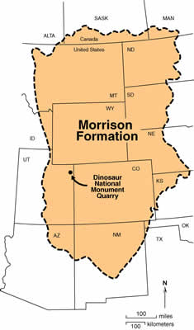
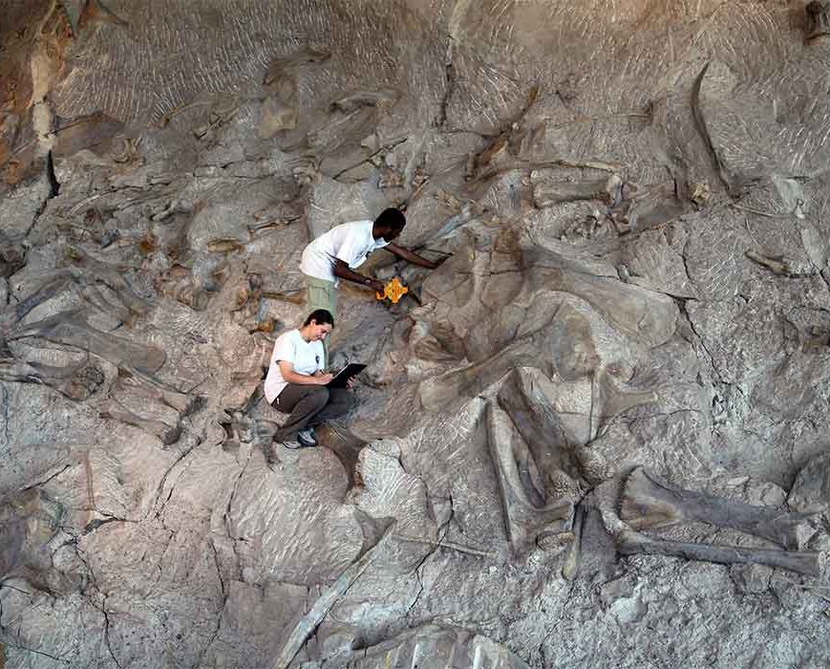
Highlights of Video – Part 4
Dinosaur National Monument
  ~1500 Dino bones in the exhibit hall alone
  But also fossil clams and snails
  Part of the Morrison Formation
    Dino bones along with sharks and fish
  Intact mixed with dismembered dinos
  (disarticulated) and other clues indicate
  they died elsewhere
  and were all
  transported here

Slide 9
Highlights – What Does the Evidence Show?
Diversity – Many different kinds of fossils all preserved w/o signs of decay; requires rapid burial
Stasis (stability) – no signs of species changing over time; just sudden “emergence” of new creatures
Complexity – complex creatures found in every strata (even the ‘oldest’ bottom levels – Cambrian “explosion”)
Un-conformities – “missing” layers representing supposed millions of years with no erosion

Slide 10
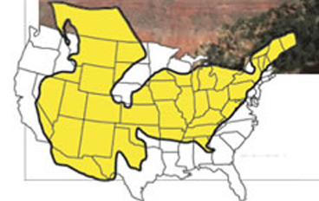
Highlights – What Does the Evidence Show?
Fossils 95% marine invertebrates, ~4% plants, <1% marine and land vertebrates (marine mixed with the land)
Continent wide layers
New discoveries include un-fossilized, original soft tissue
Death on a global scale

Slide 11
Session 5 – Flood or Fiction?

Slide 12
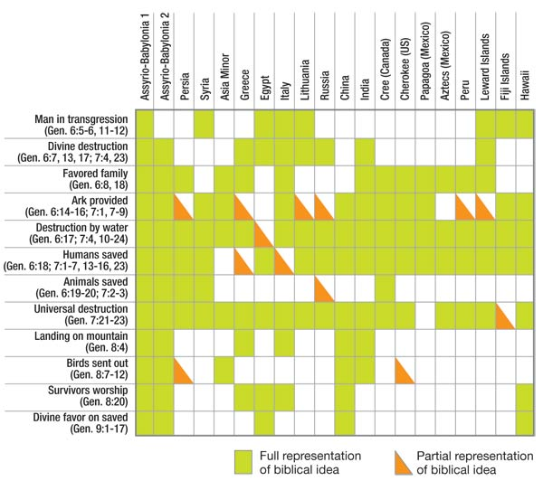
Highlights of Video – Part 5
Flood stories
from around the
world
From http://www.answersingenesis.org/articles/am/v2/n2/flood-legends

Slide 13
Present day Colorado River Carve the Grand Canyon?
A washed out spillway
Top of canyon 6900-8500 ft
(Kaibab Upwarp)
Colorado river enters canyon at 2800 ft elevation
Exits at about 1800 ft
Had to be much higher water level in the past
About 270 miles
Notes:
(11 min in new video)

Slide 14
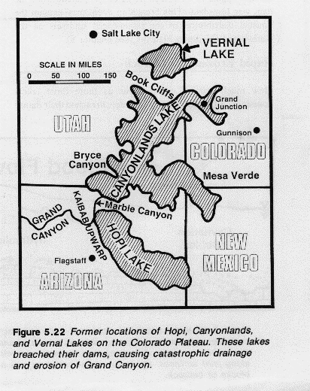
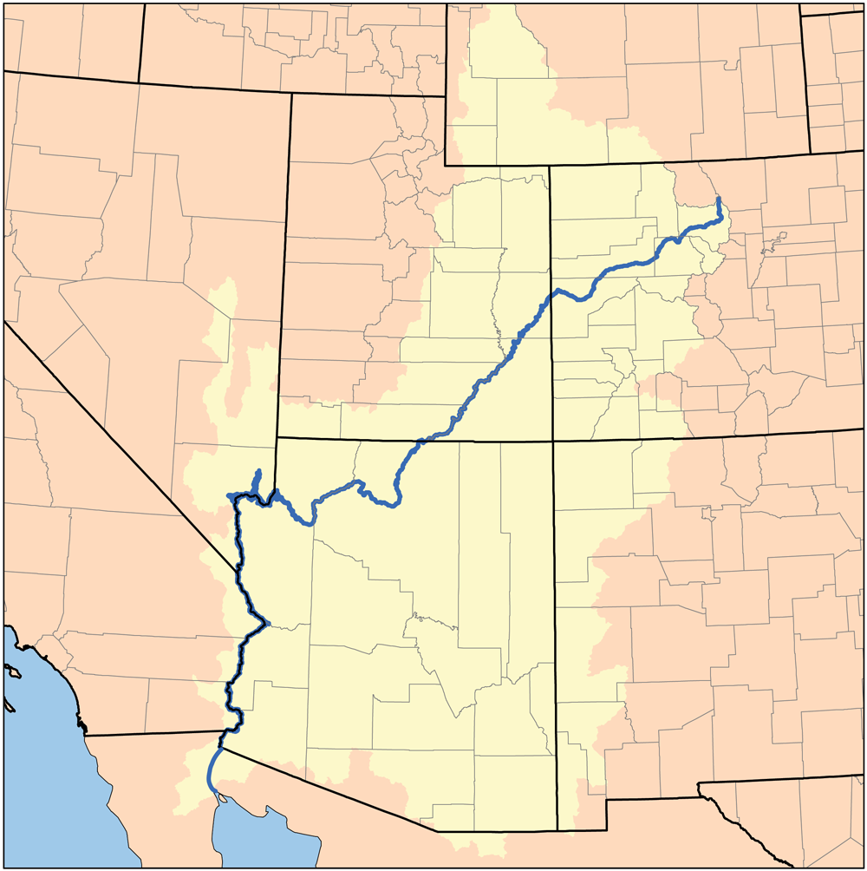
Grand Canyon
Drainage of lakes
Hundreds of feet thick layer of water. Greyhound bus size boulders rolled down
‘missing’ sediment at present river delta
  17,000ft of sediments east of San Diego
  Equal to Grand Canyon materials
From Grand Canyon: Monument to Catastrophe

Slide 15
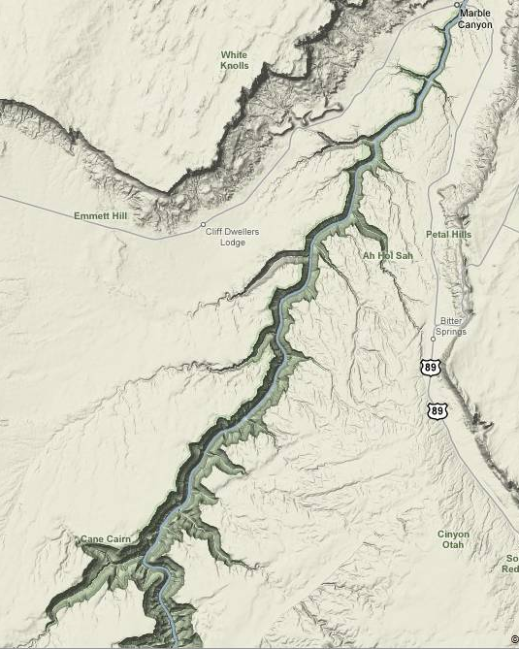
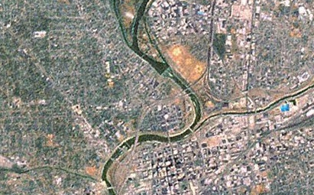
Another evidence for rapid Grand Canyon formation
Upstream of GC is evidence of lake rapidly draining
  Tributaries flowing ‘backwards’
Standard rivers merge at less than 90 degrees
Colorado river upstream of Grand Canyon (from Google maps)
Notes:
Called a barbed canyon, water runs backwards off the dam to the deepest part then turns around and runs out through the crack that has formed (which eventually became the ‘remnant’ river)

Slide 16
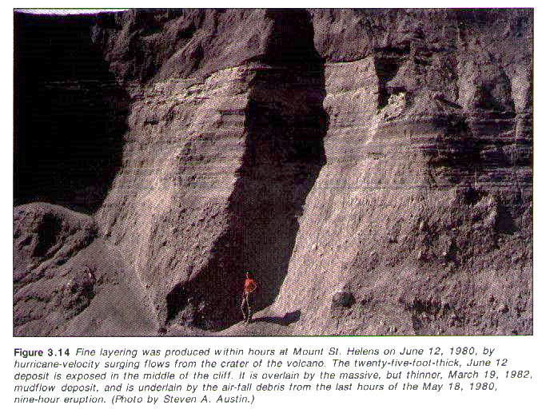
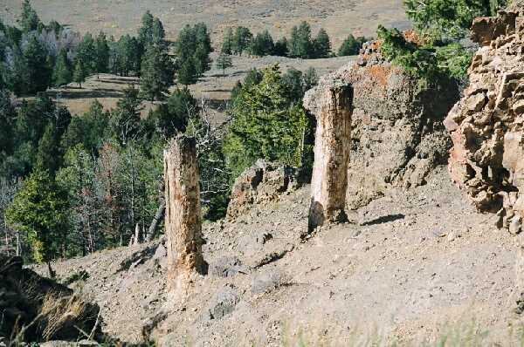
Mt St Helens
Demonstrated that much geological work can be done in a very short time
  Rapid deposition of many layers
  Rapid carving of a canyon
  Log mats in spirit lake – some sinking to bottom in upright position (polystrate fossil)
Specimen ridge, Yellowstone

Slide 17


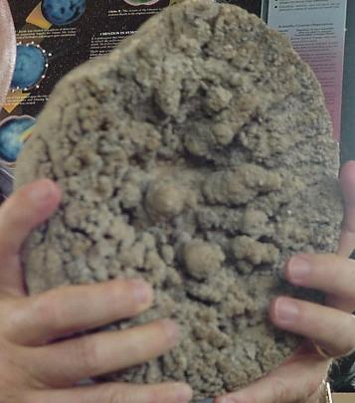
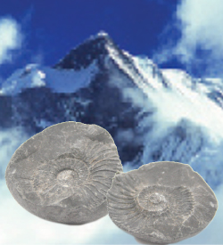
What’s the evidence
Andrew Snelling gives us 6 key evidences
  #1. Fossils of sea creatures high above sea level (even in the Himalayas!)
  #2. Rapid burial of plants
  and animals
  -fish giving birth
  -fish eating another fish
  -fossil jellyfish!
Andrew Snelling, “Geologic Evidences for the Genesis Flood” series of articles in Answers Magazine. October 2007 – April 2009

Slide 18
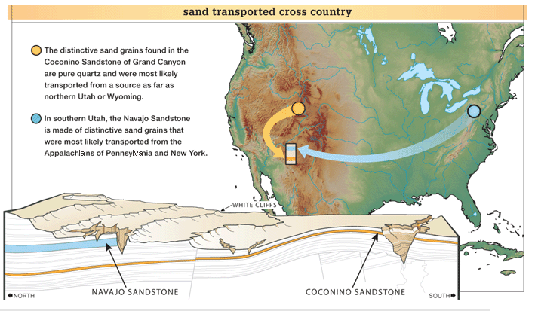
What’s the evidence?
6 key evidences
  #3. Rapidly deposited sediment layers spread across vast areas
  Example, the Tapeats Sandstone and Redwall Limestone of Grand Canyon can be traced across the entire United States, up into Canada, and even across the Atlantic Ocean to England.
  #4. Sediment transported long distances
  Example, the sand for the Coconino Sandstone of Grand Canyon (Arizona) had to be eroded and transported from the northern portion of what is now the United States and Canada.

Slide 19
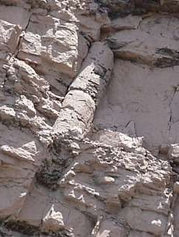
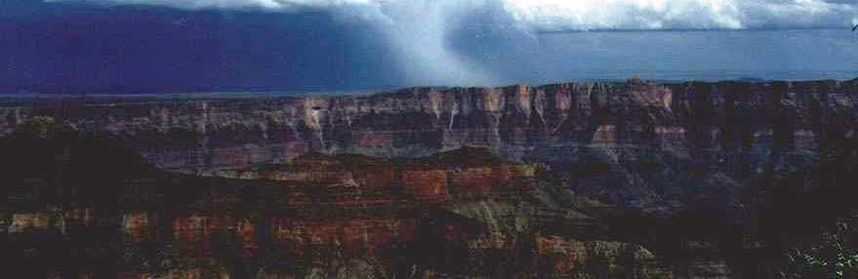
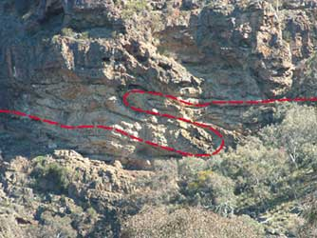
What’s the evidence?
  #5. Rapid or no erosion between strata (no millions of years between layers)
  #6. Many strata laid down in rapid succession
  folding without ‘breaking’ (had
  to still be pliable)
  polystrate fossils
Creation “Warped Earth” article
See Polystrate trees link

Slide 20
References
Dinosaur National Monument articles: https://www.icr.org/article/106/
https://creation.com/dinosaur-disarray
Flood legends: https://answersingenesis.org/the-flood/flood-legends/flood-legends/
https://www.icr.org/article/yellowstone-petrified-forests
https://www.icr.org/article/what-are-polystrate-fossils
Andrew Snelling, “Geologic Evidences for the Genesis Flood, Part I: An Overview”, Answers Magazine, Vol 2, Num 4 http://www.answersingenesis.org/articles/am/v2/n4/geologic-evidences-part-one
Steve Austin, Grand Canyon: Monument to Catastrophe, Institute for Creation Research, 1994
Tom Vail, Grand Canyon a Different View, Master Books, 2003

