Slide 1
Lesson 9: Rise of Civilization
Unlocking the Mysteries of Genesis
DVD series by The Institute for Creation Research (ICR)
Mark Jurkovich
Centerville Community Church
Centerville, Ohio
May 2019
Notes:
What evidence is there for the accuracy of the events in the Bible after the flood? This question now falls largely into the realm of archaeology. Secular and liberal scholars make claims that much archaeology finds contradict scripture. Is it true?

Slide 2
DVD Highlights
Mitochondrial Eve and Y-chromosome Adam – Genetics show all people descended from one man and one woman. (though claim each were part of a group of people)
Genetic diversity:
Common Variants
Consistent with diversity from Adam and Eve
Rare Variants
Consistent with diversity since flood (even admit arose within last couple thousand years)

Slide 3
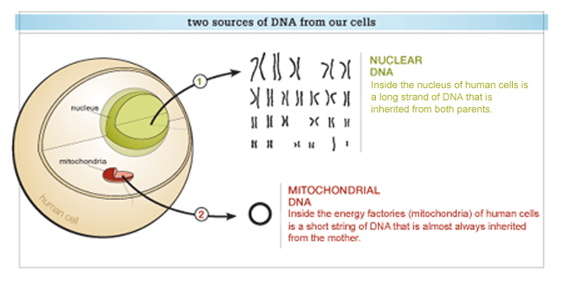
More on DNA, Adam and Eve
Two types of DNA,
Nuclear that you get from both father and mother
Mitochondrial that you only get from the mother
Research on Mitochondrial DNA has shown we all came from one ‘Eve’
Even secular researchers put the date possibly as recent as 6000 years ago
Can mean came from a single woman, or from a small group of women where the other lines ‘died out’
A “Y-chromosome Adam” has also been determined
Date of the “Adam” generally placed more recent than “Eve”
the “Adam” is actually Noah? (male line converges at Noah, but female line converges at Eve)

Slide 4
DVD Highlights
Key archaeological finds confirming the Bible
1800’s John Taylor – “Ur of the Chaldeans”
1974 tablets of Ebla – Sodom, Gomorrah and other Biblical names/places (https://www.icr.org/article/ebla-its-impact-bible-records/)
“All the cultures found in the Bible have been verified by archaeologists within the last 150 years”
Modest population growth from end of flood easily produces todays population.
Secular linguists identify ~70 different language groups – close match to number from table of nations in Genesis 10
Chinese oracle bones – pictographic memory of Genesis 1 through 3

Slide 5
Did all languages today come from Babel?
~6900 languages today
Genesis 10 lists at least 78 language families (see table of nations on next slide)
“These are the clans of Noah’s sons, according to their lines of descent, within their nations. From these the nations spread out over the earth after the flood.” v.32
According to Ethnologue and Vistawide World Languages, who both do linguistic studies, claim there are a maximum 94 language families! (ex. English is in the same family as German)
Evolutionary view of languages: expect only about one original language family.

Slide 6
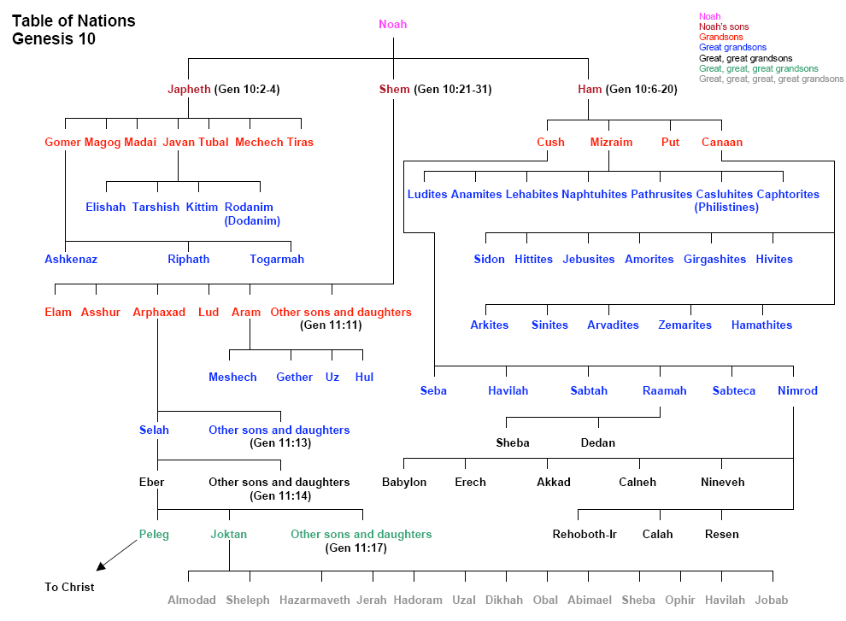

Slide 7
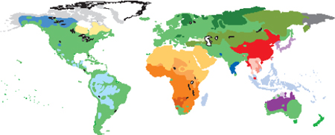
Other info on Languages
Languages are ‘devolving’
Classical Greek more complex than Koine Greek of Jesus’ day, which is more complex than modern Greek
Scientific study of languages shows clearly did NOT originate from a single language
“Secular theories fail to explain the many distinct language families throughout the world. The biblical account of Babel is the only explanation that fits the data.”
(John Oller, “More than Pie”, Answers, v3, n2, p 54)

Slide 8
More about Babel
Judgement at Babel - Mild judgment considering the severe judgment of the flood – they did not want to be scattered/make a name for themselves
30 ziggurats in Mesopotamian area still have names that reflect a tower that reaches to the heavens
Temple of the stairway to pure heaven (Sippar)
Temple which links heaven and earth (Larsa) …
Ziggurats in the area are pyramidal shaped
Ancient ziggurats found all over world

Slide 9
Ancient towers (at Ark Encounter)

Slide 10
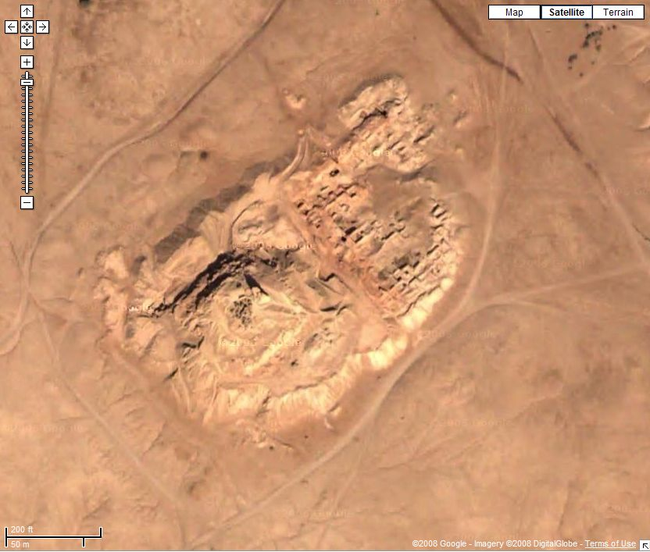
Birs Nimrod – Remnants of Babel?
Birs Nimrod - “The mound of Nimrod”
Remnants of the tower of Babel?
Base 49,000 sq ft; 300 ft high (same as 8 section ziggurat that was 650 ft high and already ancient in 440 BC?)
DVD: “Genesis, Babel & the Chinese Language”, Dr. Andy McIntosh, Ans. in Gen., 2004
Notes:
Babel in days of peleg?

Slide 11
Migrations after Babel
Olmecs – predate the Myans, claimed to have come by boat from the east (Africa) – had a written language, family similar to the Mende of West Africa!
Japheth/Meshech – the old name for Moscow
Japheth/Javan – Hebrew for Greece
Ham/Cush is Ethiopia, still called that today
Ex. Sino-Japanese war – some Sinites migrated from Sinai peninsula to the orient!
Jews still call Germany Ashkenaz for the son of Gomer
Ice age allowed ocean level to drop opening up land bridges to Americas and Australia

Slide 12
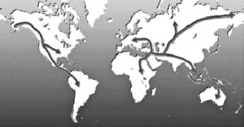
Explosion of civilizations
2348 Flood Ends (estimated dates)
2247 Peleg Born
2242 Tower of Babel
2234 Babylon founded (Sumer?)
2188 Egypt Founded
2089 Greece Founded
Others founded around the same time: Assyria, Elam (Persia), Indus Valley in India, China, Dinmun (Arabian Peninsula?), Minoan (Crete), Nazca, Inca & Pre-Inca (Peru), Maya (Central Am)
Notes:
The fairly rapid progression of civilizations showing up around the world is consistent with people spreading out from Bable.
Carlisle Cathedral, NW England – Bishop Richard Bell grave mid late 1400’s – pictures of dinosaurs. Alchasorus, Apatosaurus, and two others

Slide 13
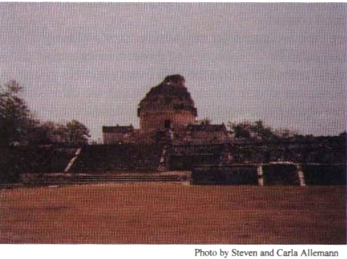
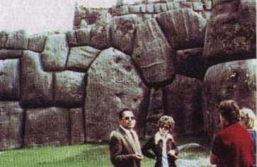
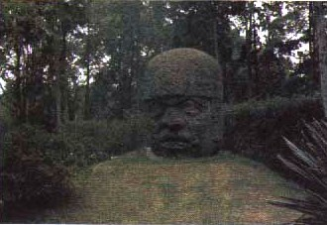
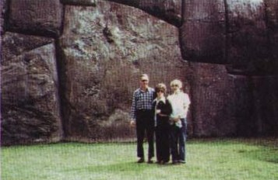
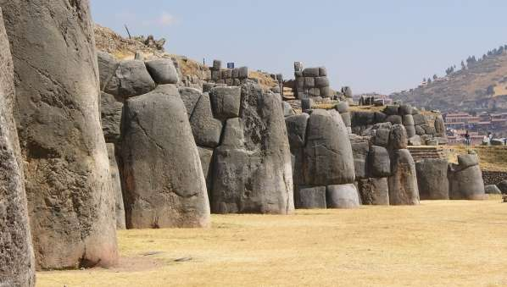
Ancient civilizations were advanced
Accurate astronomy in Central America
Pyramids in Egypt, China, S. America, and Japan – 2 or 3 blocks had to have been lowered at same time
Mammoth perfect fitting stones in Sachsahuaman Peru
Bolivian stone faces of peoples from all over the world
Notes:
“Mayan Observatory at Chichen Itza. Using astronomical measurements, the Mayans constructed a calendar more accurate than that in use today.” (Chittick, The Puzzle of Ancient Man)
The stones fit perfectly but are not rectangular. … Cuzco, Peru walls with up to 20 ton blocks (even a 200 ton block) (“couldn’t even put a razor between the blocks”)

Slide 14
Ancient genealogies
Virtually all the names in the table of nations in Genesis 10 validated in extra Biblical records
Ancient myths traced back to Noah and/or son (tended to deify their ancestors)
Japheth – Iapetos in Greek, Pra-Japati in India Sanskrit, Father Jove/Jupiter in Roman
Ancient royal lines also traced back
Anglo Saxons, Danes, Norwegian, Celtic trace back to Noah
Detailed in After the Flood by Bill Cooper

Slide 15
Babel legends
Though not as abundant as flood legends, Babel type legends exist around the world
Accounts in ancient Egypt, Hundu, Buddhist, China, Polynesia, Maya, N. Am. Indians, East Africa
Couple of examples
“…everybody began to speak a different tongue except that each husband and wife talked the same language” (Pam Sheppard, “Tongue-Twisting Tales”, Answers Magazine)
Gaikho tribe in Myanmar “the people determined to build a pagoda that should reach up to heaven. . . . When the pagoda was half way up to heaven, God came down and confounded the language of the people, so that they could not understand each other. Then the people scattered”

Slide 16
More on Archaeology – 2 Examples

Slide 17
Dating the Exodus
Exodus 12:40-42 Now the length of time the Israelite people lived in Egypt was 430 years. At the end of the 430 years, to the very day, all the LORD's divisions left Egypt. Because the LORD kept vigil that night to bring them out of Egypt, on this night all the Israelites are to keep vigil to honor the LORD for the generations to come.
1 Kings 6:1 In the four hundred and eightieth year after the Israelites had come out of Egypt, in the fourth year of Solomon's reign over Israel, in the month of Ziv, the second month, he began to build the temple of the LORD
Notes:
From these two key passages we have the number of years between Israel’s entry into Egypt, the Exodus, and the building of Solomon’s temple.
How does it compare to secular dating?

Slide 18
Dating the exodus
Secular Egypt Chronology
18th dynasty
(Amenophis II
d. ~1425 BC)
1st dynasty
~ 3100 BC
Pyramids
~ 26000 BC
4000 BC
3500 BC
3000 BC
2500 BC
2000 BC
1500 BC
1000 BC
Creation
~ 4000 BC
Methusaleh
b. ~ 3300 BC
Global Flood
Bet. 2348 and
2302 BC
Abraham
b. ~2000 BC
The Exodus
~ 1445 BC
Temple
started
~ 966 BC
Biblical Chronology
Egypt chronology based on Manetho in 3rd century BC (after fall of Egypt) who compiled length of Pharaohs’ reigns. None of his writings survived, only as quoted by later historians (inc. Josephus and Eusebius), and these sometimes conflict.
Archeologists simply summed up the reigns. But many of the reigns were contemporary, significantly shortening the total length of the Egyptian empire. (ex. 16th & 17th dynasties where one king ruled the delta region and a vassal king ruled the upper Nile region from Thebes.)
According secular chronology, the exodus would be during an affluent period of Egypt, nor do the records of Cana show evidence of Israel's arrival (inc. Jericho not inhabited at this time). Secular historians therefore put the exodus to the 12th century BC and regard it as a minor migration.
Correcting for overlapping dynasties puts the 12th dynasty around the time of the exodus in ~1445 BC. And the 18th dynasty was then at the time of Solomon and Rehoboam.
Notes:
Secular dating of this part of the world are based on the chronology derived from ancient Egypt.
More recognizable example of a vassal king is king Herod who was under Caesar.

Slide 19
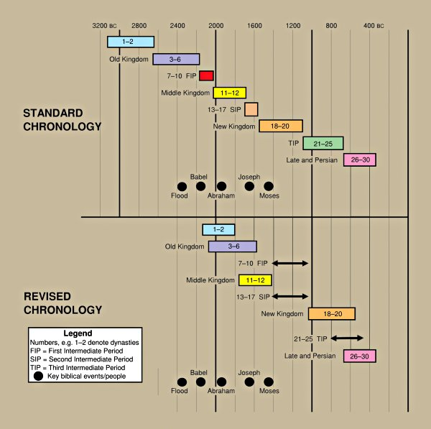
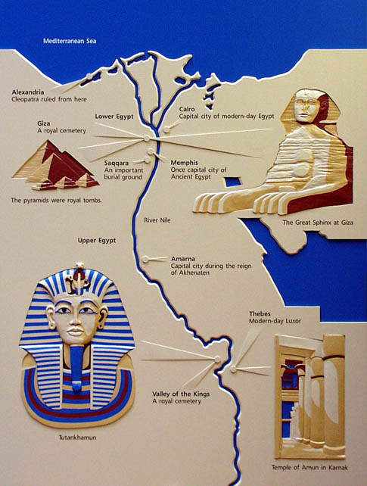
Revised Egypt Chronology
http://heartofwisdom.com/homeschoollinks/geography-of-ancient-egypt/
“Timing is everything: A talk with field archaeologist David Down”,
Creation, Vol 27, n 3, 2005
Notes:
So with the revised chronology, we see the first dynasty starting right after Babel, and the intermediate periods come after the collapse of Egypt from the 10 plagues and drowning in the Red Sea. The new kingdom is then properly named as Egypt finally recovers and throws off the invaders

Slide 20
Israel and the 12th Dynasty
Joseph to Egypt 1688 BC (Amenemhet I)
1673 Sesostris I
Joseph Vizier 1668
Jacob to Egypt 1660 (during famine)
1628 Amenemhet II
1592 Sesostris II
Joseph dies (age 110) 1589
oppression 1572 Sesostris III
1531 Amenemhet III
Moses born/flees 1525/1485
1483 queen Sobekneferu
(Dynasty 13) 1456 Neferhotep I
The Exodus 1445 (Hyksos invade Egypt)
Notes:
With this revised chronology, we can now see how Biblical history and Egypt history coincide. We will refer back to this chart, so I have included it in your handout so you can follow along.

Slide 21
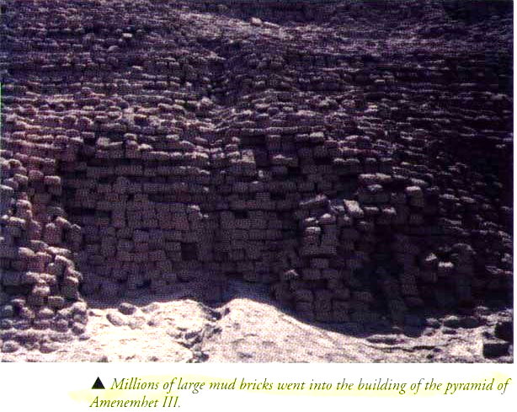
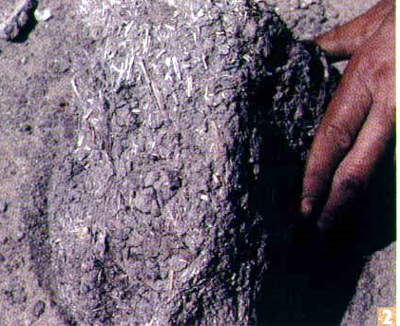
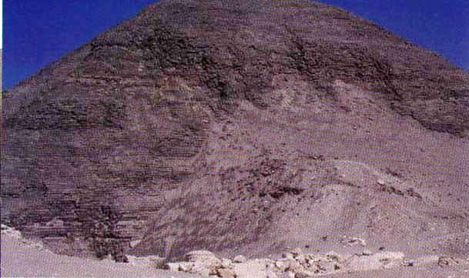
Matching Evidence from Revised Chronology
Sesostris I had a vizier, Mentuhotep who matches well with Joseph!
A canal dug during the 12th dynasty is called Joseph’s canal
Writings from this period mention a 7 year famine
Pyramids of this period made of mud bricks

Slide 22
Links to the Exodus
Sesostris III matches description of cruel tyrant who would oppress Israel
Archaeological evidence supports Semitic (from the line of Shem, i.e. Israelites) slavery in latter half of 12th dynasty
Amenemhet III had no son, fits with willingness to adopt Moses as grandson (daughter later took over (Moses’ adopted mother?))
The Ipuwar Papyrus, which can be dated to this time describes many of the plagues that struck Egypt!
Neferhotep’s (13th dynasty) tomb never found (drowned with army?)
13th dynasty ended with the collapse of the central rule, and the country was a shambles. The Hyksos then swarmed into Egypt and occupied it without a battle (no Egyptian army left to fight them!)
Evidence of Jericho and the rest of Cana in this era matches the invasion of Israel.

Slide 23
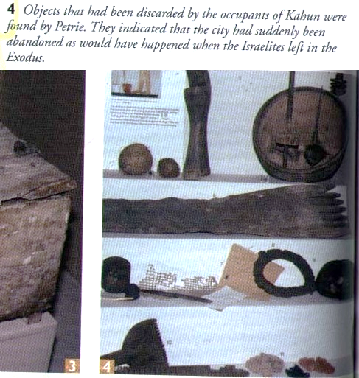
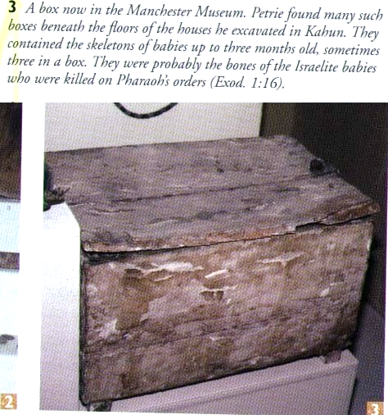
Further links
Town of ‘Asiatic’ slaves (i.e. not African)
Graves initially showed prosperity, then lack of it and dying at younger ages
Many coffins of babies
Many items left behind as in inhabitants leaving quickly

Slide 24
Other Links Between Egypt and Israel
Queen of Sheba who visited Solomon would be Queen Hatshepsut, who left detailed record on the walls of her temple at Deir el-Bahri of her visit to the land of Punt, which she refers to as God’s land.
Shishak of 1 Kings 14:25 (“In the fifth year of King Rehoboam, Shishak king of Egypt attacked Jerusalem.”), would be the great military conqueror Thutmosis III, who left a relief on the wall of his shrine at Karnak of all the treasures he brought back from Jerusalem. Velikovsky points out how accurately they correspond with the contents of Solomon’s temple as detailed in the Book of Chronicles.

Slide 25
Patterns of Evidence – The Moses Controversy
A Semitic language, predating Phoenician discovered in Egypt, Sinai and Israel, in that order.
Old Hebrew, Phoenician, and other Semitic languages likely derived from it
Old Hebrew most closely matches it
Logical that it originated from Joseph himself
Strong evidence against liberal scholarship claiming there was no alphabet available for Moses to write the 1st 5 books.
(C 2019 Virgil Films)

Slide 26
Jericho

Slide 27
Joshua 3:14-17
So when the people broke camp to cross the Jordan, the priests carrying the ark of the covenant went ahead of them. Now the Jordan is at flood stage all during harvest. Yet as soon as the priests who carried the ark reached the Jordan and their feet touched the water's edge, the water from upstream stopped flowing. It piled up in a heap a great distance away, at a town called Adam in the vicinity of Zarethan, while the water flowing down to the Sea of the Arabah (the Salt Sea) was completely cut off. So the people crossed over opposite Jericho. The priests who carried the ark of the covenant of the LORD stood firm on dry ground in the middle of the Jordan, while all Israel passed by until the whole nation had completed the crossing on dry ground.

Slide 28
Joshua 6:15-20
On the seventh day, they got up at daybreak and marched around the city seven times in the same manner, except that on that day they circled the city seven times. The seventh time around, when the priests sounded the trumpet blast, Joshua commanded the people, "Shout! For the LORD has given you the city! The city and all that is in it are to be devoted to the LORD. Only Rahab the prostitute and all who are with her in her house shall be spared, because she hid the spies we sent. But keep away from the devoted things, so that you will not bring about your own destruction by taking any of them. Otherwise you will make the camp of Israel liable to destruction and bring trouble on it. All the silver and gold and the articles of bronze and iron are sacred to the LORD and must go into his treasury." When the trumpets sounded, the people shouted, and at the sound of the trumpet, when the people gave a loud shout, the wall collapsed; so every man charged straight in, and they took the city.

Slide 29
Joshua 6:21-25
They devoted the city to the LORD and destroyed with the sword every living thing in it—men and women, young and old, cattle, sheep and donkeys. Joshua said to the two men who had spied out the land, "Go into the prostitute's house and bring her out and all who belong to her, in accordance with your oath to her." So the young men who had done the spying went in and brought out Rahab, her father and mother and brothers and all who belonged to her. They brought out her entire family and put them in a place outside the camp of Israel. Then they burned the whole city and everything in it, but they put the silver and gold and the articles of bronze and iron into the treasury of the LORD's house. But Joshua spared Rahab the prostitute, with her family and all who belonged to her, because she hid the men Joshua had sent as spies to Jericho—and she lives among the Israelites to this day.

Slide 30
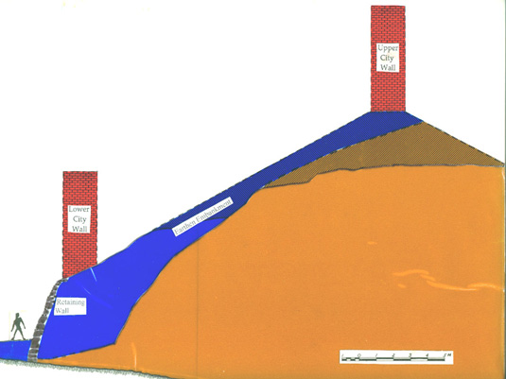
Evidence for Bible account of Jericho
Fallen walls except in one place (Rahab’s house?)
Walls ‘fell flat’ – collapsed walls created ramps
Full grain jars (harvest time, not plundered)
Burning evident throughout
Image from http://www.biblearchaeology.org/post/2008/06/09/The-Walls-of-Jericho.aspx
Notes:
Tell (mound) Jericho
1930s John Garstang worked 6 seasons “The episodes of the event are confirmed in the material particulars. The fallen walls have been laid bare, while the burning of the buildings is found to be so general and conspicuous as to suggest a deliberate holocaust”
1950s Kathleen Kenyon variation to standard excavation technique. Concluded Jericho could not have been a populated city at the time of Joshua
Bryant Wood investigated more.
Ai generally thought to be Et Tell “the ruin” ; but 27 acres – too large; and clearly uninhabited during conquest
Ai of Genesis (which could be Et Tell) not the same Ai of Joshua
Byzantine church at the location because they believed to be site of Ai

Slide 31
More on Ancient Chinese
Remnants of Eden and the flood stories found in the Chinese characters themselves
Since all peoples have the flood and Babel in common, we see flood and Babel stories all around the world
But it is also buried in the Chinese characters themselves!
Shang-Ti ; “the High God” who originally made the world

Slide 32
Bible in Chinese Characters
Notes:
God’s truth has been handed down by Noah “and it is actually there in the Chinese language”
To hand down/continue – 8 + mouth/people + water
Shang-Ti their God “the High God” who originally made the world
desire/covet – trees + woman
To punish – to doubly offend + knife
Me – hand + lance (by my own hand)
Righteousness – me + sheep (a lamb over me/a sacrifice/blood atonement)

Slide 33
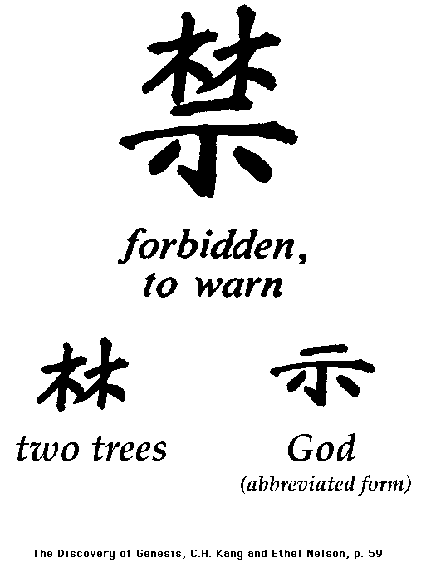
Chinese Characters

Slide 34
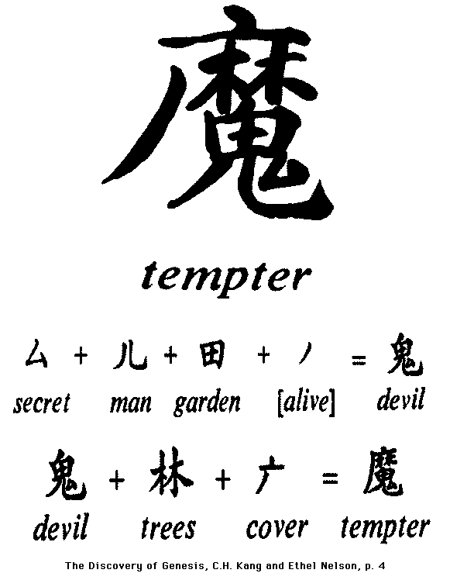
Chinese Characters

Slide 35
References
DVD: “Genesis, Babel & the Chinese Language”, Dr. Andy McIntosh, Ans. in Gen., 2004
Tower of Babel issue, Answers magazine, Vol 3, No 2, Apr-Jun 2008
“Search for the Tower of Babel” http://www.answersingenesis.org/articles/am/v3/n2/search-for-babel
“Genetics and Biblical demographic events”, http://www.answersingenesis.org/tj/v17/i1/events.asp
Wieland, C., A shrinking date for ‘Eve’, CEN Tech. J. 12(1):1–3, 1998
“More Than PIE: Babel Explains Distinct Language Families”, http://www.answersingenesis.org/articles/am/v3/n2/more-than-pie
https://answersingenesis.org/tower-of-babel/tongue-twisting-tales/
Michael Oard, “Setting the Stage for an Ice Age” http://www.answersingenesis.org/articles/am/v2/n2/setting-stage-for-ice-age
Michael Oard, Frozen in Time, Master Books, 2004 http://www.answersingenesis.org/home/area/FIT/index.asp
Donald Chittick, The Puzzle of Ancient Man, Creation Compass, 1997
Bill Cooper, After the Flood, New Wine Press, 1995
Eric von Fange, Noah to Abram: the Turbulent Years, 1994

Slide 36
References
The Associates for Biblical Research, http://www.biblearchaeology.org/
Video: “The Second Great Battle of Jericho”, AVM Presentations, 1998, with Dr. Bryant Wood
Jericho article http://www.biblearchaeology.org/post/2008/06/09/The-Walls-of-Jericho.aspx
David Down, “The Age of the Earth and Biblical Chronology”, Creation Ex Nihilo, Vol. 9 No. 3, June 1987
David Down, “Timing is Everything”, Creation, Vol 27, n 3, 2005, http://creation.com/timing-is-everything
John Ashton & David Down, Unwrapping the Pharaohs: How Egyptian Archeology Confirms the Biblical Timeline, Master Books, 2006 https://answersingenesis.org/archaeology/ancient-egypt/pharaohs-of-the-oppression/
“Matthew Maury’s search for the secret of the seas”, Creation, v11 n3, June 1989, http://www.answersingenesis.org/articles/cm/v11/n3/maury
Searching for Moses, by David Down, April 1, 2001 http://www.answersingenesis.org/articles/tj/v15/n1/moses
Nelson, Broadberry, Tong Chock, God’s Promise to the Chinese, Read Books Pub., 1997
Dr. Allan Steel, Languages: the Bible vs. Evolution (DVD), Answers in Genesis

Slide 37
Supplemental Material

Slide 38
Enough people to build tower?
“How many people are required to build a tower of unknown size?”
Generations after flood
Noah, Shem/Ham/Japheth
Arphaxad 2 years after flood
Shelah 37 years
Eber 67 years
Peleg 101 years
Reu 131 years (prob. after Babel)
So 6 generations alive at time of Babel
At 5 or 6 sons average ➔ 2300 to 5000 men at Babel
Notes:
Quick estimate puts population around 10,000. may sound small, but they were more advanced than we give credit for.

Slide 39
Decrease in longevity?
Genetic bottlenecks at the flood and Babel
After flood 3 generations ~445 yrs, after Babel 3 generations ~235 years, then another drop
Ancestor worship – great great grandfather was outliving you (even Greek gods/immortals still died, just outlived everyone else)

Slide 40
Every generation alive when Abraham’s father was born!!
http://www.answersingenesis.org/articles/2009/01/20/ancient-patriarchs-in-genesis

