Slide 1
Lesson 6:
How Old is Earth?
Unlocking the Mysteries of Genesis
DVD series by The Institute for Creation Research (ICR)
Mark Jurkovich
Centerville Community Church
Centerville, Ohio
May 2019

Slide 2
What does the Bible Say?
Pattern of Genesis 1, “evening and morning was the x^{th} day” – clear reading defines “day” as a single rotation of the earth.
Remember the Sabbath day… For in six days the Lord made the heavens and the earth, the sea, and all that is in them, but he rested on the seventh day. Therefore the Lord blessed the Sabbath day and made it holy. (Ex 20:8-11 & 31:17)
Notes:
God refers back to creation week as a pattern for a sabbath every 7th day. All other ways to mark of time (day, month, year) have an astronomical tie, but not the week. Its pattern was set by God from creation week.

Slide 3
What does the Bible Say?
The genealogies of Genesis 5 & 11, along with other key verses are the main reason Biblical creation is set to around 6000 years ago
  Other verses: Abraham – Gen 11:26, 25:7
  Isaac – Gen 21:5, 35:28
  Jacob – Gen 25:26, 47:28
  430 years in Egypt – Ex 12:40, Gal 3:16-17
  480 years from Egypt to Solomon’s temple – 1 Ki 6:1
  Date for laying foundation of temple – “reliably certainty is 967 BC”

Slide 4
How old is the earth?
A straight reading of the Bible puts the age of the earth at around 6000 years (meaning of ‘day’ is one rotation of the earth, genealogies in Genesis 5 and 11)
Does the evidence support this?
Doesn’t the size of the universe and radiometric dating prove otherwise?
Notes:
We will look at the astronomical dating in another session. Today we will look at many terrestrial methods that point to the validity of the age of the earth based on Scripture.

Slide 5
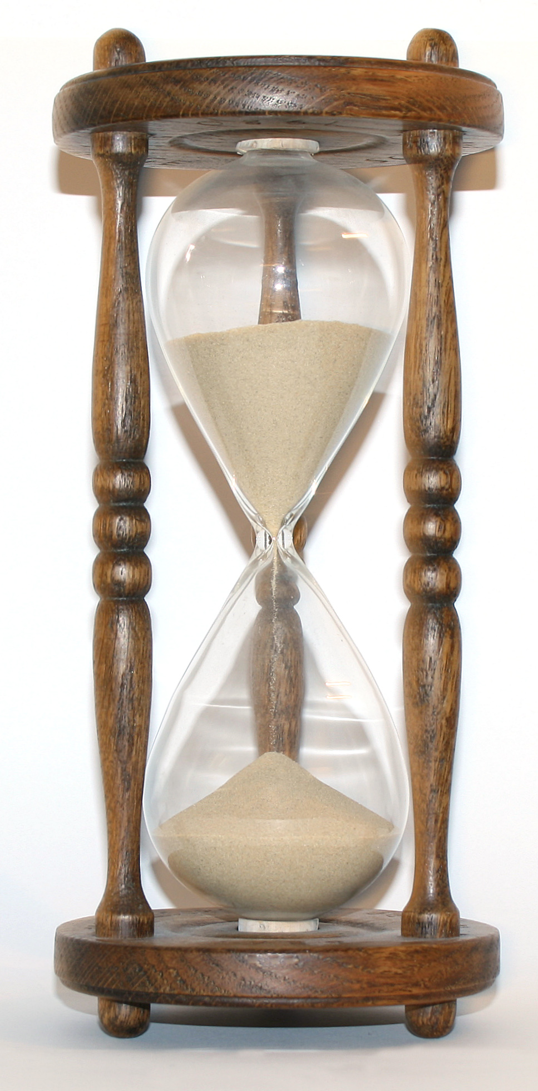
DVD Highlights
Radiometric dating assumptions
  Assume constant decay rate
  Assume closed system
  Assume known initial conditions
The evidence puts these
assumptions into serious question

Slide 6
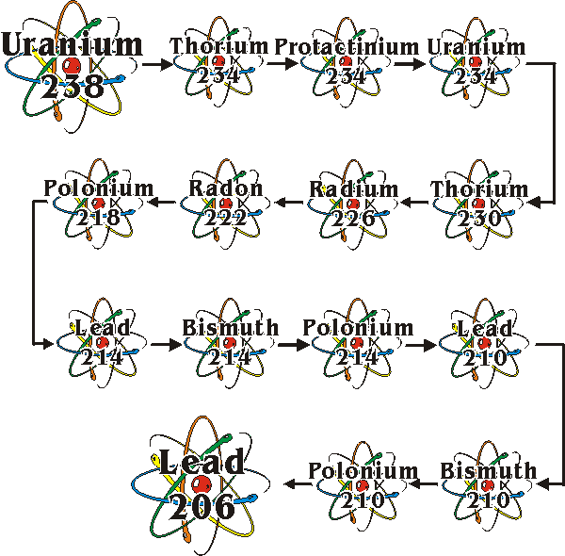
What is radiometric dating?
Uranium 238 goes through many decays to finally become Lead
All radioactive elements go through one or more decays to become a stable element
Each stage consists of either an alpha decay (helium nucleus) or a beta decay (neutron converting to a proton)
The rate at which each stage decays to the next is known
α
β
(beta minus decay, a neutron is converted into a proton, an electron, and an electron antineutrino)

Slide 7
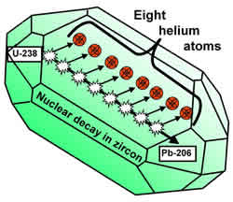
Zircons and Helium
(RATE study)
Creation scientists have developed a fascinating new method for dating rocks, based on Helium diffusion
The alpha particles (Helium) produced by radioactive decay eventually diffuse out of the rock
Measurements show ‘too much’ Helium remains in rocks for them to be millions of years old
Recent RATE study on Helium diffusion shows strong evidence for accelerated nuclear decay rates in the past (after the fall, during and/or shortly after the flood)
The amount of helium left show age of rocks only ~6000 years, not millions

Slide 8
Carbon 14 sample dates
The following items should be so ‘old’ that they ‘should not’ have enough Carbon 14 left to measure
Coal from Russia from the ‘Pennsylvanian’, supposedly 330 million years old, dated at 1,680 years.
Natural gas from the Cretaceous and Eocene layers — should have been 50 to 135 million years old. C14 gave dates of 30,000 and 34,000, respectively.
Bones of a saber-toothed tiger from the LaBrea tar pits, supposedly 100,000 years old, gave a date of 28,000.
A block of wood from the Cretaceous (supposedly more than 70 million years old) found encased in a block of Cambrian rock (hundreds of millions of years earlier), gave a date of 4,000 years.
Diamonds, allegedly millions of years old, giving dates of only tens of thousands of years (no chance for leaching in or out of them!)

Slide 9

Carbon 14 in the atmosphere
Amount of radiocarbon in atmosphere is still increasing
At present rate of production, would take 30,000 years to come to equilibrium
Long agers either ignore this fact, or claim the concentration is ‘cyclic’
  But if cyclic, then how can you rely on it anyway?
At present rates, there was no radiocarbon in atmosphere 7 to 10 thousand years ago
  i.e. a ‘young’ atmosphere
  Rates likely even slower to negligible before the flood
Means the older something is, the less radiocarbon it had in it when it died
  Dates need to be adjusted to account for these lesser concentrations in the past (so something carbon dated to 50,000 years old, can easily be 5,000 instead)
The atmosphere is still “filling up” with C-14

Slide 10
Other dating “discrepancies”
‘new’ Mt. St. Helens rock dates 348,000 to 2.8 million years old
Fresh lava in Hawaii dated at 3 million to 1 billion years old
Living clam dates thousands years old
Fur from live seal 20 thousand years
Mammoth hair 26 thousand years while peat soil found in only 5,600 years
Note: A 2010 creation article shows relative dates do follow a general trend with strata layers, but NOT the absolute dates (“Radiometric Dating: Making Sense of the Patterns”, Answers Magazine, Jan 2010, p72)

Slide 11
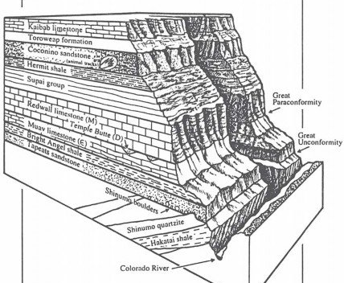
Grand Canyon
Ten things to know about the Grand Canyon
Great unconformity – dividing line between pre-flood and flood rocks. Spreads around whole world
Marine Transgression: a progressive pattern of sandstone under shale under limestone. This pattern is attributed to a rapid increase in sea level or increasing water depth
Cambrian Explosion: The sudden appearance of many fossils with no fossils in the layer below it
From talk by Dr. John Whitmore, Geology professor, Cedarville Univ.

Slide 12
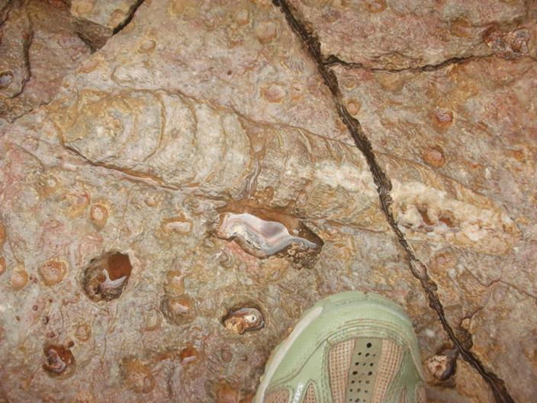
Grand Canyon
Whitmore Nautiloid Bed: Redwall Limestone layer, mostly lined up in the same direction, buried in a strong current. This strongly contradicts the claim by evolutionary geologists that limestone was laid down slowly.
Flat contacts between layers “as far as eye can see”: no erosion between layers
Many of these layers are continent
and worldwide
Folded layers: had to still be soft
Nautiloid

Slide 13
Grand Canyon
Coconino cross beds: not fossilized sand dunes, but marine origin
Radiometric dating: many dates on the same rock disagree with each other, and that later lava flows date older than some of the rocks it flowed over.
Colorado river is not actively eroding out the bedrock under it (breached dam better explanation)
  lack of talas (debris at the bottom of the steep canyon walls); indicates the canyon cannot have been around for millions of years
“secular geologists are losing their ‘evidence’ for long ages” (every layer is now looking to have been laid down rapidly by water)
Coconino cross beds

Slide 14
Other evidence for a young earth/universe

Slide 15
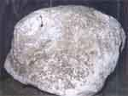
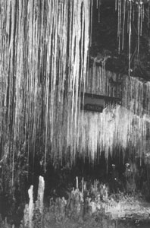
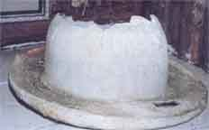

Things form rapidly
Items thought to take a long time to form shown to form quickly
  Coal and oil formed rapidly in lab tests
  ‘young’ oil found coming from volcanic vents in ocean
  Mammoth selenite (sp) crystals naturally forming in just 30-100 years
  Stalactites forming rapidly under man made structures
  Rapid petrification
Petrified bowler hat
Petrified bag of flower from 1886 eruption
In a 55 year old mine
Notes:
Flower from flooded mill in 1910, Eureka Springs, Arkansas

Slide 16

What’s a Radiohalo?
When radioactive material decays in solid rock, it leaves scarring
Each type of decay leaves a distinctive size scar
Scars from decay of Polonium show evidence of metamorphic rocks forming rapidly in the global flood (Polonium has a very short half-life, one of the intermediate elements in Uranium decay)
“Polonium Radiohalos: The Model for
Their Formation Tested and Verified” http://www.icr.org/article/2467/

Slide 17
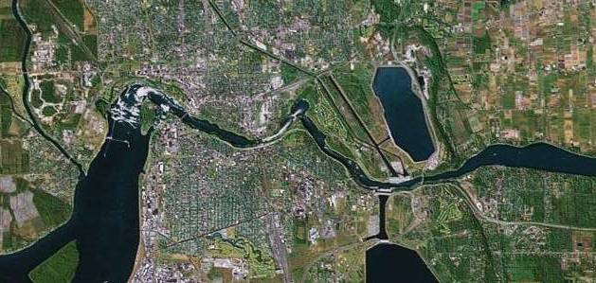
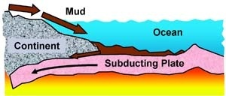
Other items indicating a young earth
At current erosion rates, Niagara falls is at most 7-9000 years old (much younger taking post flood conditions into account)
Not enough mud on the sea floor (~20 billion tons accumulates per year. Sediment should be dozens of kilometers deep, but is only 400 meters deep)

Slide 18
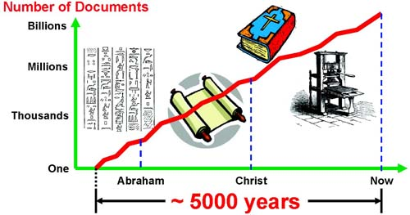
Other items indicating a young earth
Earth’s magnetic field is decaying (evidences of rapid reversals during the flood) Life would not have been possible much longer than 6,000 years ago
Not enough Stone Age skeletons
  If humans have been around 185,000 years, should be about 8 billion stone age graves. But only a few thousand have been found
  Historical population growth also fits man starting over after the flood 4500 years
Agriculture and written history also too recent to fit with stone age man being around for 185,000 years

Slide 19
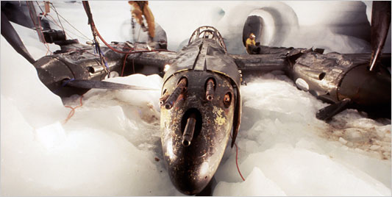
More evidence
Topsoil formation rates indicate only a few thousand years of formation
Ice cores at the south pole and Greenland have a maximum depth of 10-14,000 feet. The aircraft that crash-landed in Greenland in 1942 and excavated in 1990 were under 263 feet of ice after only 48 years. This indicates all of the ice could have accumulated in 4400 years. http://thelede.blogs.nytimes.com/2007/06/22/plane-freed-from-a-glacier-sets-out-for-britain-again/

Slide 20
Summary
Radiometric dating methods shown to be wholly unreliable
New dating method based on Helium diffusion shows age of earth consistent with Biblical account
Many other methods of estimating age of earth (and universe) also show earth cannot be billions of years old

Slide 21
References
“Carbon-14 dating - explained in everyday terms”, Ex Nihilo 2(2):14–18, April 1979 http://www.answersingenesis.org/creation/v2/i2/carbon14.asp
RATE references:
  Dr Don DeYoung, “Thousands not Billions”, Master Books, 2005 (also a DVD)
  http://www.icr.org/pdf/research/Helium_ICC_7-22-03.pdf
  “Helium Diffusion Rates Support Accelerated Nuclear Decay”, Fifth International Conference on Creationism August 4-8, 2003 http://www.creationicc.org/abstract.php?pk=191
  https://www.icr.org/article/new-rate-data-support-young-world
How accurate are Carbon-14 and other radioactive dating methods? http://www.christiananswers.net/q-aig/aig-c007.html
“The 10 Best Evidences from Science that Confirm a Young Earth”
http://www.answersingenesis.org/articles/am/v7/n4/ten-best-evidences
Evidence for a Young World http://www.icr.org/article/1842/

Slide 22
More References
101 evidences for a young age of the earth and the universe: https://creation.com/age-of-the-earth
Dating Niagara Falls, http://www.icr.org/article/123/
Rapid Petrification of Wood: An Unexpected Confirmation of Creationist Research http://www.icr.org/article/13/
Rapid petrification http://www.answersingenesis.org/creation/v18/i1/tarawera.asp
How old is the earth? http://www.answersingenesis.org/articles/2007/05/30/how-old-is-earth#fnList_1_19
Age of the Universe, http://www.answersingenesis.org/articles/tba/age-of-the-universe-2
Review of Dr. Whitmore talk on Grand Canyon http://www.arky.org/newsltr/arknl2402.pdf , Page 3.
https://answersingenesis.org/geology/grand-canyon-facts/fossil-evidence-grand-canyon/

