Slide 1
Lesson 3: What is Man?
Mark Jurkovich
Centerville Community Church
Centerville, Ohio
April 2019

Slide 2
Scripture on Man
Genesis 1:26-27 Then God said, “Let Us make man in Our image, according to Our likeness; let them have dominion over the fish of the sea, over the birds of the air, and over the cattle, over all the earth and over every creeping thing that creeps on the earth.” So God created man in His own image; in the image of God He created him; male and female He created them.
Notes:
According to the Bible, we are not just another animal. We were made separate from all the animals, and in a very special way. And we were given dominion over all the animals.

Slide 3
Scripture on Man
Psalm 8:3-9 When I consider Your heavens, the work of Your fingers, The moon and the stars, which You have ordained, What is man that You are mindful of him, And the son of man that You visit him? For You have made him a little lower than the angels, And You have crowned him with glory and honor. You have made him to have dominion over the works of Your hands; You have put all things under his feet, All sheep and oxen— Even the beasts of the field, The birds of the air, And the fish of the sea That pass through the paths of the seas. O Lord, our Lord, How excellent is Your name in all the earth!
Notes:
The Psalmist beautifully restates Genesis 1, marveling at the blessed position we have been places in.

Slide 4
DVD Unlocking the Mysteries of Genesis, Part 3 What is Man?

Slide 5
Highlights of Video
DNA similarity to chimps?
NOT the 98 -99 % similar as often spouted (over small section of genome)
Closer to 70% over whole genome ➔ 900 million differences! ; impossible in supposed time allotted from common ancestor
Came from outer space??? (pushing off the problem)

Slide 6
Highlights, continued
What makes us unique?
Differences in anatomy, ex. ability of hands
Ability to build, create, make art, music,…
Abstract thought
Spiritual connection ; God’s desire for companionship with us ; for genuine, compassionate fellowship with us (Rom 5:8, Phil 2:13 …for his good pleasure)
Notes:
Rom 5:8 But God demonstrates His own love toward us, in that while we were still sinners, Christ died for us.
Phil 2:13 for it is God who works in you both to will and to do for His good pleasure.

Slide 7
More highlights - Problems with evolution
“None of the major steps of evolution have been recapitulated in the lab”
Evolution happens too slowly to be observed (by their own admission)
By Darwin’s own pen, we should reject evolution – “If it could be demonstrated that any complex organ existed, which could not possibly have been formed by numerous, successive, slight modifications” his “theory would absolutely break down.” (step by tiny step processes)

Slide 8
The Uniqueness of Man*
What separated man from apes?
Unique bipedal design
Uniquely skillful hands
Unique fine skin
Unique facial expressions
Unique language & speech
We are designed for far more than survival
* DVD by Prof. Stuart Burgess, 2014 from Answers in Genesis)

Slide 9
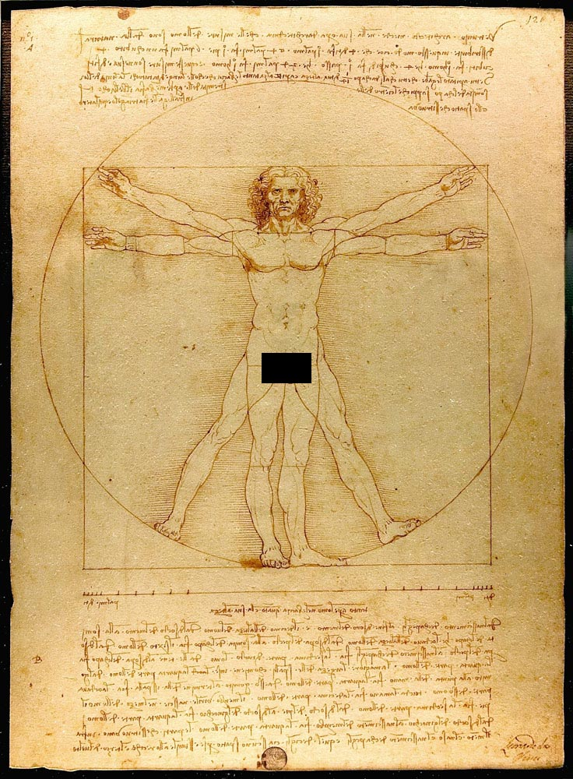
The Uniqueness of Man
What separated man from apes?
Unique childhood
Unique marriage and reproduction
Unique brain
Unique beauty of human form
Unique soul
We are overdesigned (in a positive sense), comparing the human body to a luxury sports car that is designed to go faster than it needs to, is more comfortable than needed, and more beautiful than needed.
Notes:
Da Vinci’s Vitruvian Man shows how we are beautifully proportioned

Slide 10
Our bipedal design
We are the only mammal that walks upright

Slide 11
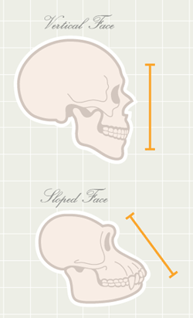
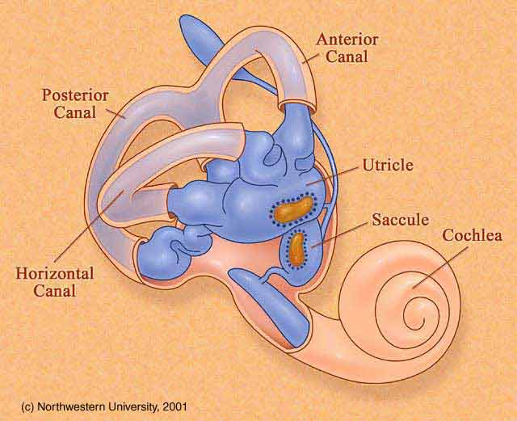
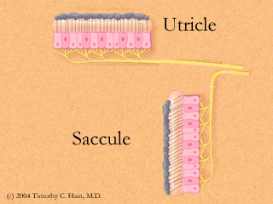
Our bipedal design
Vertical balance: accelerometers and 3-axis gyros build into our ears! (the vertical one of the 3 canals in the inner ear is uniquely enlarged for upright balance(?))
Flat face (so we can see the ground in front of us while walking upright)
Notes:
“These sensory organs, particularly the utricle, have an important role in the righting reflexes and in reflex control of the muscles of the legs, trunk, and neck that keep the body in an upright position” https://www.britannica.com/science/ear/The-physiology-of-balance-vestibular-function

Slide 12
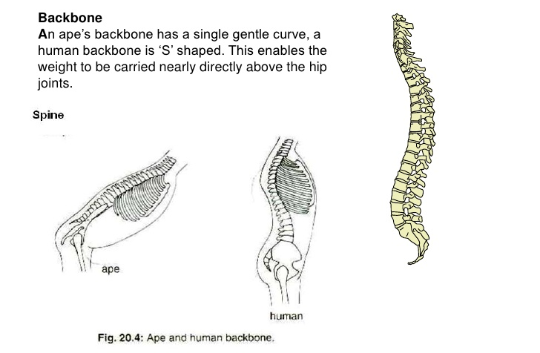
Our bipedal design
Upright neck joint (enters the skull from underneath; not so in apes)
S shaped spine (keeps center of gravity vertically above hips; better for suspension and cushioning in jumps for example)

Slide 13
Our bipedal design
Upright hips, angled femurs, upright knees and long legs all enable upright standing and walking
Arched feet (gives us 3 points of contacts for best stability; apes cannot stand on one leg)
Strong big toe (further stability and helps enable standing on front of feet and pushing off of front of feet)
Notes:
Basic, but important tripod design

Slide 14
Unique hands
Our ability to make a pinch grip with our thumb and any of our fingers, and make combined grips
We have full range of motion from flat hand to clenched fist; apes only have a curve grip
We have fine muscle control for precise movement
Fine touch sensors on fingertips
Precise design of muscles and ligaments for all these abilities listed above
25% of our brain’s motor cortex is dedicated to muscles in the hand!
(apes only have a curve grip)
Notes:
All these unique features for upright posture free up our hands for other uses. So it makes sense that our hands are also a marvel of unique design.
Also

Slide 15
Unique hands
Precise design of muscles and ligaments for all these abilities listed previously
Ex. Tripod grip to hold writing utensils
All together enables the incredible skills of a musician, to a surgeon, to even the skills for knitting
25% of our brain’s motor cortex is dedicated to muscles in the hand!
Notes:
Practically none of these abilities can be explained by evolutionary survival reasons.
It was all designed so we can glorify God with our hands.

Slide 16
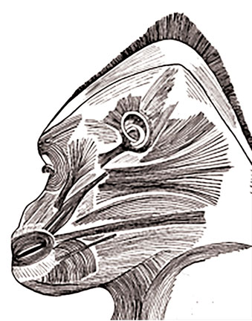
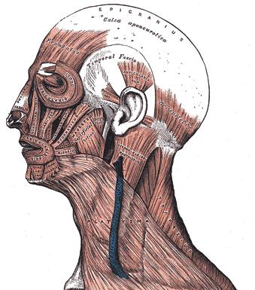
Facial muscles
We have around 50 facial muscles, half of which are dedicated to facial expression; apes have half that many muscles, none of which are dedicated for facial expression
Another 25% of our brain’s motor cortex is dedicated to facial muscles!
Even the fact that you can see the white of our eyes is unique; for example, making contact from across a crowded room.
Notes:
One of the more fun unique designs he points out is our ability for unique facial expressions.

Slide 17
Facial muscles
Facial expressions communicate feelings quickly and enhance other forms of communication
Studies say we can make 10,000 different facial expressions!
Notes:
One of the more fun unique designs he points out is our ability for unique facial expressions.

Slide 18
Summary
We were created special, and separate from the animals
We were assigned dominion over the animals
Our genetic differences are vastly greater than can be accounted for by evolutionary means (~30% different from apes, not 1-2%)
We have very significant anatomical differences from apes.

Slide 19
Dr. Burgess declared “man is a glorious being and brilliantly designed”.
“I will praise thee; for I am fearfully and wonderfully made: marvelous are thy works; and that my soul knoweth right well.” (Psalm 139:14, KJV)

Slide 20
References
https://answersingenesis.org/human-body/uniqueness-of-man/
https://answersingenesis.org/human-evolution/what-makes-us-human/uniqueness-of-humans/
Excerpt from Uniqueness of Man DVD: https://www.youtube.com/watch?v=nF82qc9ouYE&rel=0
https://creation.com/overdesign-in-humans-and-facial-expressions
Ear images: https://commons.wikimedia.org/wiki/File:Vestibular_organs-_canals,_otolith,_cochlea.jpg
http://www.dizziness-and-balance.com/disorders/bppv/otoliths.html

Slide 21
Lesson 4 preview - fossils
How are fossils formed?
Do they take a long time to form?
Does it requires special conditions?
What is the geologic column?
Does it point to millions of years of accumulation?

Slide 22
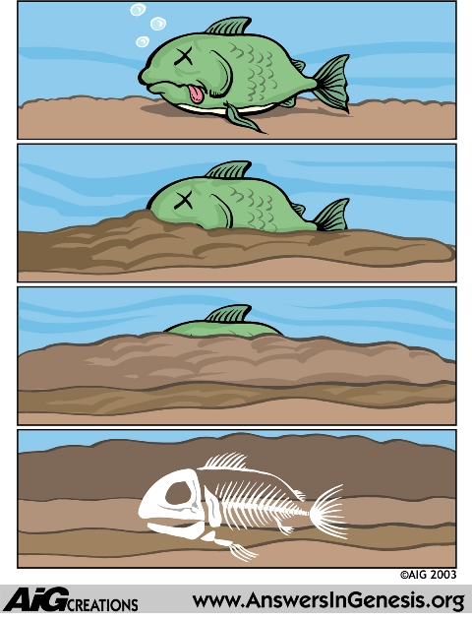
Fossils: uniformitarian view
Notes:
Pictured is the evolutionary description of how fossils are formed.
Dead animal sinks to the bottom of a lake; slowly gets buried; then fossilizes.

Slide 23
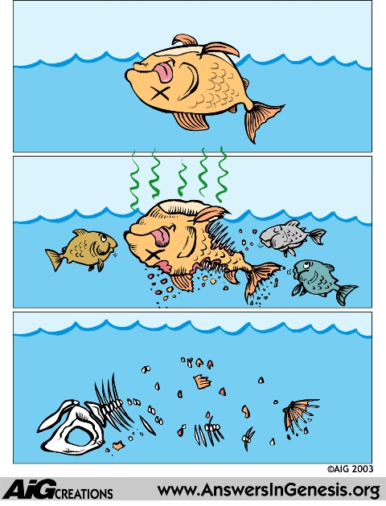
What really happens (under normal conditions)

Slide 24
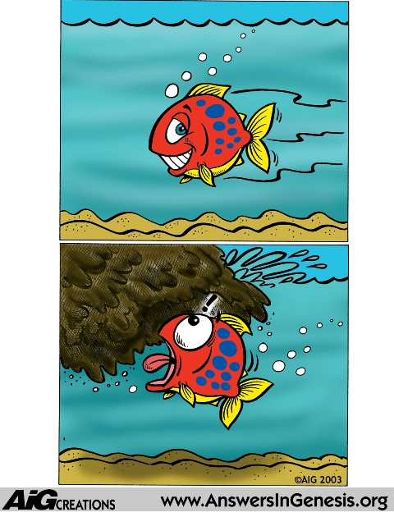
Global flood view of fossil formation
Notes:
If the flood is true, animals would be buried as they are drown and covered with flood sediment.

Slide 25
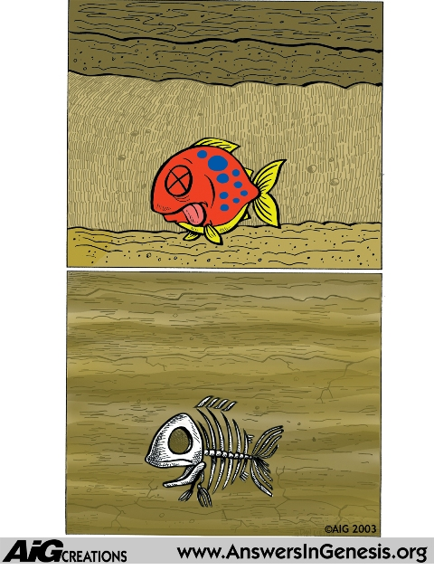
Fossils formed catastrophically
“billions of dead things buried in rock layers laid down by water all over the earth” (Ken Ham)
Notes:
The evidence clearly shows animals were buried rapidly.
Secular scientists are finally admitting that fossils are only formed under catastrophic conditions. They just refuse to admit that it occurred over one global catastrophe, and claim each was a regional flood, with many years between events.

Slide 26
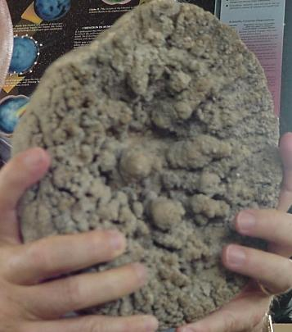
Examples of rapid burial
Fish buried while eating another fish
Fish buried while giving birth
Fossil jellyfish

Slide 27
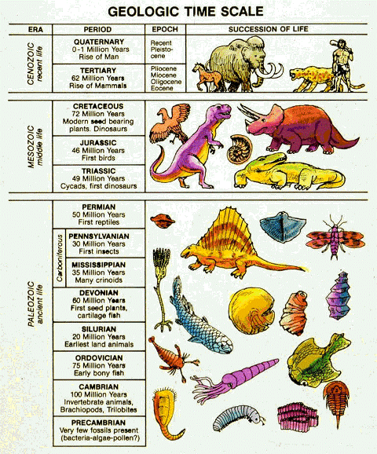
Fossil layers
The geologic column does not exist anywhere on earth
If existed all together in one place, would be 100 miles thick* (max thickness <50 mi; many layers in the one ‘complete’ location in Poland must be much thinner than expected)
Frequent missing layers
Frequent layers out of order
Species just appear, not one verified transitional form of the countless that should be there
‘Primitive’ fossils at bottom are not primitive (ex. complex eye of trilobites)
63 m years ago
230 m years ago
425 m years ago
600 m years ago
Unlocking the Geologic Record
http://www.answersingenesis.org/articles/ee/geologic-record
Notes:
Yes there are stratified layers of sedimentary rock all over the earth. Yes it does represent successive burials. But does it represent millions of years of gradual sediment buildup, or a rapid global catastrophe?

Slide 28
The Geologic Column
Bryce
Zion
Only a portion of the geologic column exists in the grand canyon
If combined with Zion and Bryce which are in the same region of the country, you get most of the column
Partially missing?
Grand Canyon
Ohio
Missing!

Slide 29
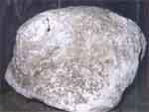
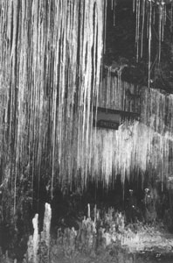
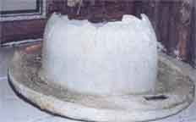
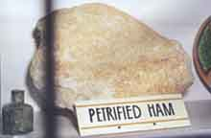
Things form rapidly
Items thought to take a long time to form shown to form quickly
Coal and oil formed rapidly in lab tests
‘young’ oil found coming from volcanic vents in ocean
Mammoth selenite (sp) crystals naturally forming in just 30-100 years
Stalactites forming rapidly under man made structures
Rapid petrification
Petrified bowler hat
Petrified bag of flower from 1886 eruption
In a 55 year old mine
Notes:
Flower from flooded mill in 1910, Eureka Springs, Arkansas

