Slide 1
Lesson 10: Origin of the Universe (Astronomy)
Unlocking the Mysteries of Genesis
DVD series by The Institute for Creation Research (ICR)
Mark Jurkovich
Centerville Community Church
Centerville, Ohio
June 2019

Slide 2
Astronomy related scripture
Genesis 1:14-16
And God said, "Let there be lights in the expanse of the sky to separate the day from the night, and let them serve as signs to mark seasons and days and years, and let them be lights in the expanse of the sky to give light on the earth." And it was so. God made two great lights—the greater light to govern the day and the lesser light to govern the night. He also made the stars.
Genesis 15:5
He took him outside and said, "Look up at the heavens and count the stars—if indeed you can count them." Then he said to him, "So shall your offspring be.“
Job 26:7
He stretcheth out the north over the empty place, and hangeth the earth upon nothing.
Job 38 31-33
"Can you bind the beautiful Pleiades? Can you loose the cords of Orion? Can you bring forth the constellations in their seasons or lead out the Bear with its cubs? (KJV Arcturus with his sons?) Do you know the laws of the heavens? Can you set up God's dominion over the earth?

Slide 3
Astronomy related scripture
Psalm 8:3-4
When I consider your heavens, the work of your fingers, the moon and the stars, which you have set in place, what is man that you are mindful of him, the son of man that you care for him?
Psalm 102:25-27
In the beginning you laid the foundations of the earth, and the heavens are the work of your hands. They will perish, but you remain; they will all wear out like a garment. Like clothing you will change them and they will be discarded. But you remain the same,
Psalm 147:4
He determines the number of the stars and calls them each by name.
II Peter 3:5
the earth was formed out of water and by water
(also Job 9:8-9, Ps 104, 148:3-4, Prov 3:19, 8:27, Is 34:4, 40:22, 48:13, 51:13, Amos 5:8, Zech 12:1, 1 Cor 15:40-42 Heb 1:10-12, Rev 10:6)

Slide 4
Some of those heavenly objects which declare the Glory of God

Slide 5
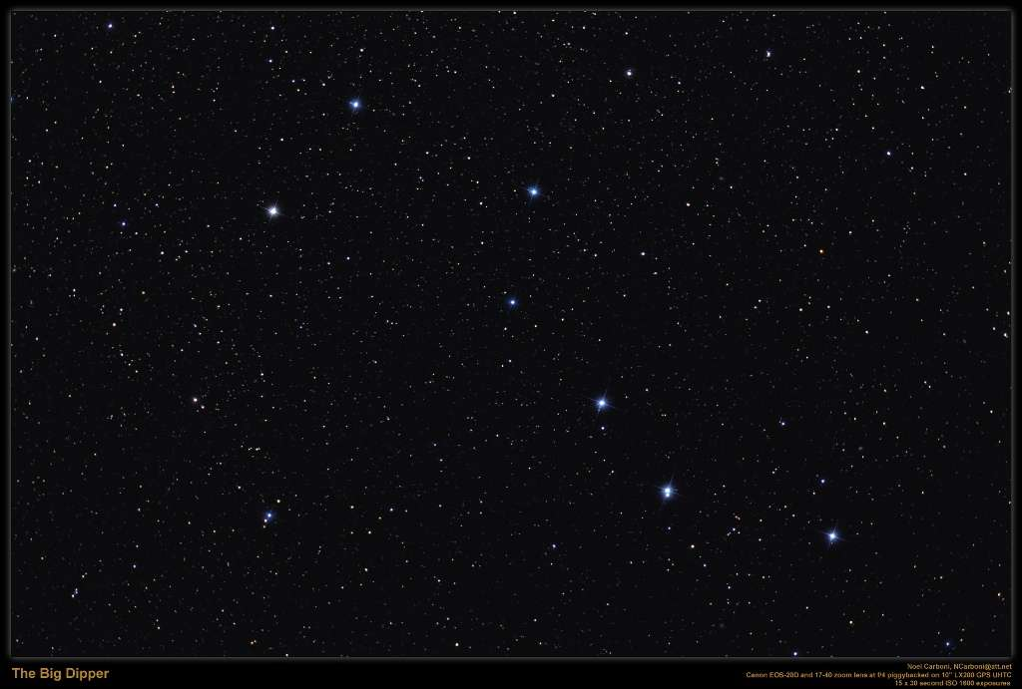

Slide 6
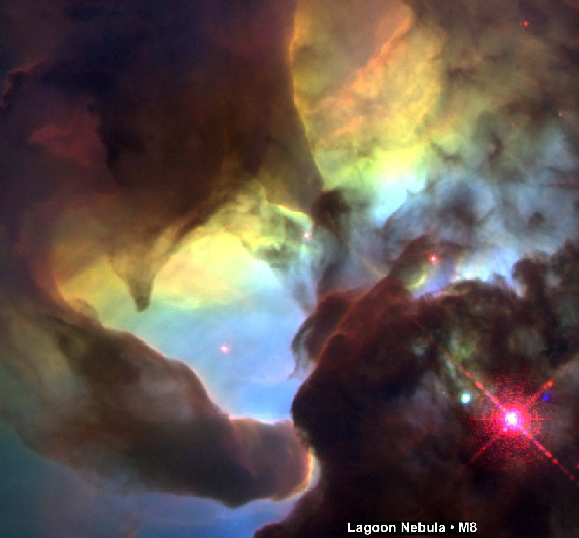

Slide 7
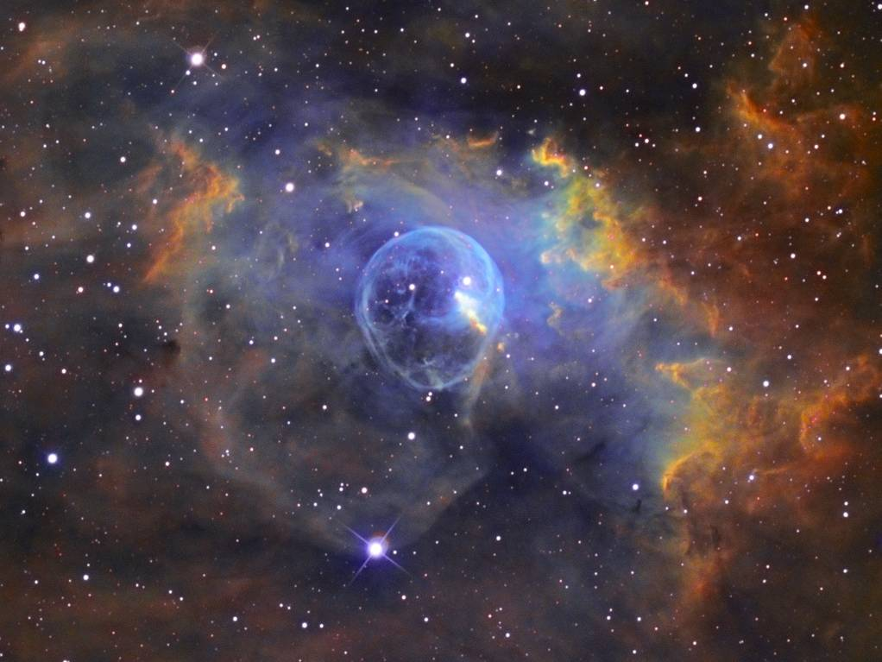
The Bubble Nebula (NGC 7635)

Slide 8
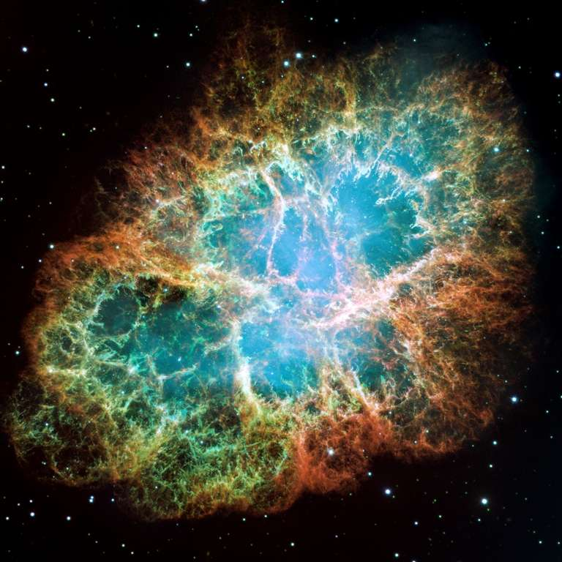
Crab Nebula (NGC 1952)

Slide 9
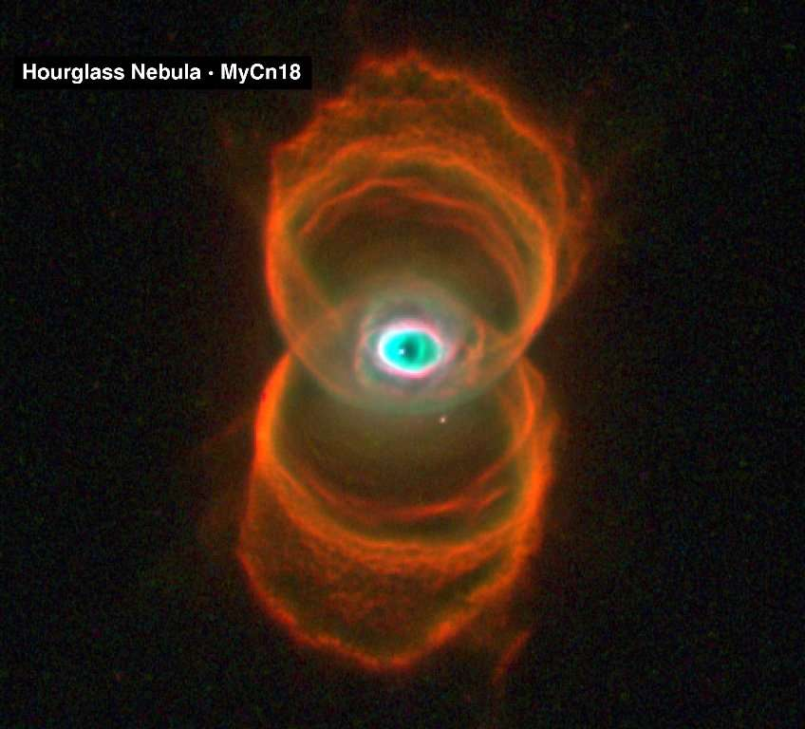

Slide 10
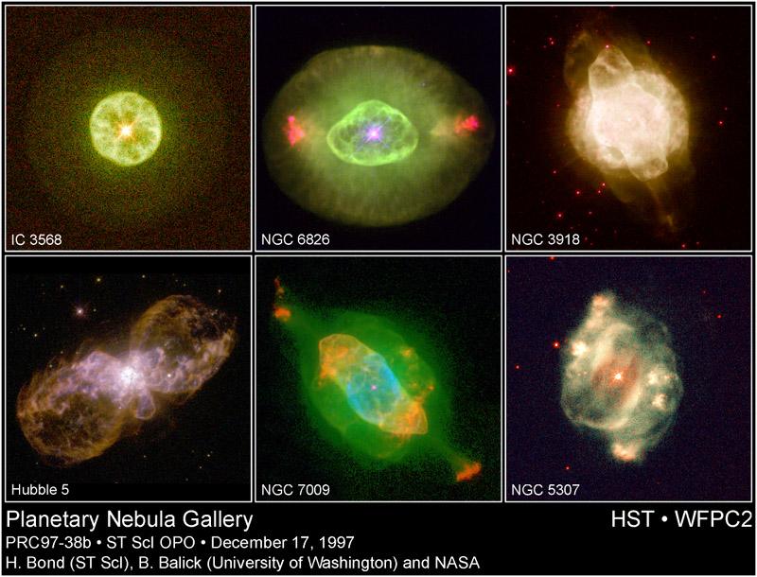

Slide 11
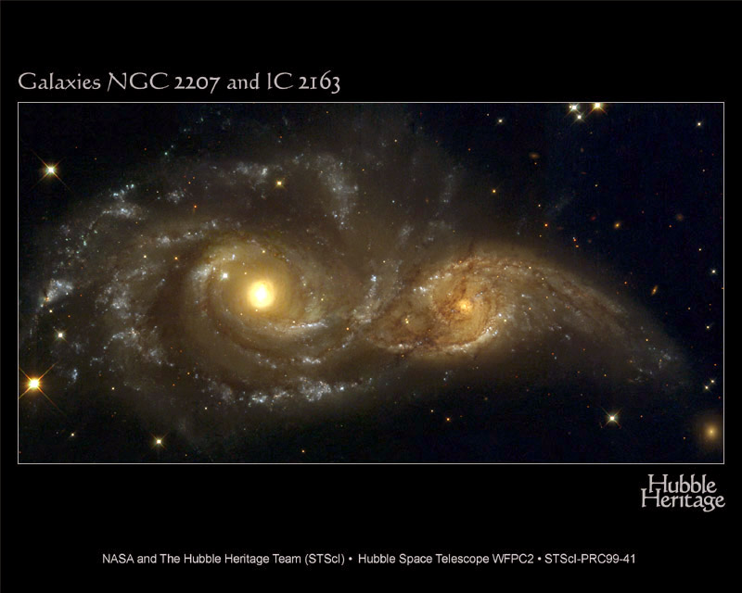
Galaxies in collision

Slide 12
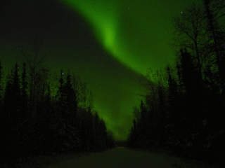
(source: Andre Clay, http://www.spaceweather.com/aurora/gallery_24nov01.html )

Slide 13
DVD Highlights - Laws of nature
Law of cause and effect/first cause
  “Every effect has a specific and predictable cause. Every cause or action has a specific and predictable effect.”
1st law of thermodynamics
  “energy can be transformed from one form to another, but can be neither created nor destroyed”
2nd law
  the amount of usable energy will always decrease; goes from order to disorder
Notes:
As I pointed out in lesson 2, for evolution to have occurred, a number of fundamental laws of nature and science have to be violated!
When something becomes a law, that means man is confident enough to say we have never seen an exception to this law.
“Scientific laws (also known as natural laws) imply a cause and effect between the observed elements and must always apply under the same conditions.”

Slide 14
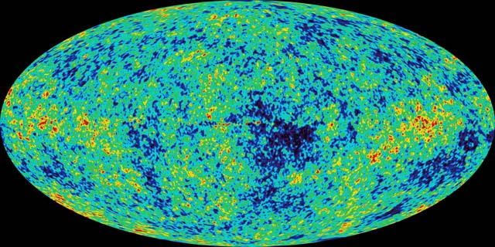
DVD highlights
Cosmic Microwave Background (CMB)
  Should be substantial variations, but extremely uniform (100 times smaller)
  “Inflation” supposed to answer this, but violates their own principals of uniformitarianism
  Isopotry (being the same in all directions) – does not look the same in all directions as predicted

Slide 15
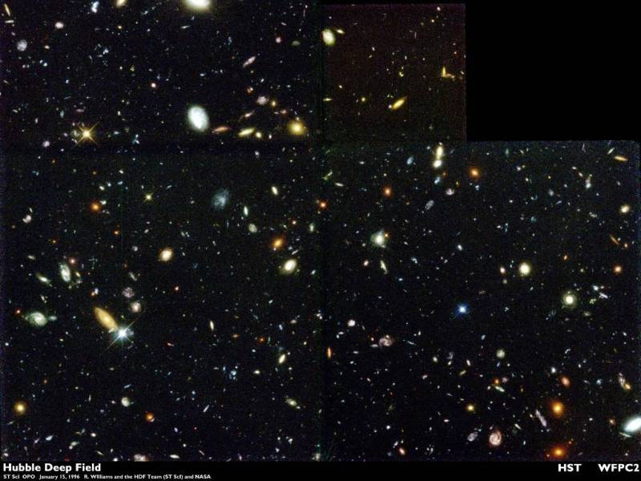
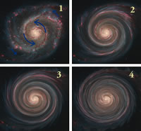
Evidences for a young universe
“The Bible is not an astronomy textbook, but when it touches on astronomy, it’s right”
Blue stars – expend fuel too quickly – cannot last hundreds of millions of years
Mature galaxies near edge of universe
Spiral Galaxies should
be more ‘twisted’ – inner
portion rotates faster
than outer

Slide 16
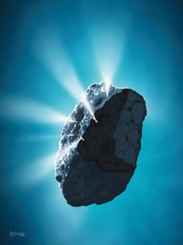
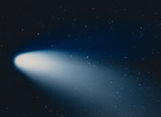
More on young universe
Jupiter and Neptune emit ‘too much’ energy to be 4.5 billion years old
Dr. Russ Humphreys correctly predicted planetary magnetic fields based on Biblical time scale
Recession of the Moon (would be ‘touching the earth’ 1+ billion years ago, see next slide)
Comets cannot exist for billions of years (no evidence for Ort cloud)

Slide 17
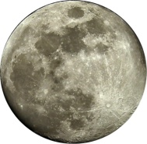
Recession of the Moon
Distance from Earth
1.4 bya
1.0 bya
today
Time
Unless the earth captured the moon sometime in the last billion years, it cannot be that old. No mechanism has been identified for the earth to have captured it.
Notes:
Tidal forces actually cause the moon to move away from us. Insignificant in the Biblical time line, but becomes unworkable in evolutionary time scales.
The separation rate dr/dt, is strongly dependent on the total earth-moon distance r.

Slide 18
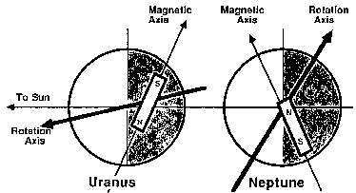
Evidences for a young universe
Planet rotations don’t fit evolutionary theory
Sun rotates ‘too slow’
Planets orbiting other stars don’t fit evolution theory (too big/too close)

Slide 19
Universe too big to be young?
Big Bang Theory has it’s own distant starlight problem (called the Horizon Problem)
  Even supposed 14 billion years is not enough time for distant reaches of universe to come to the same temperature, but it is the same temperature!
  A theory called the inflation model to try to get around this has no evidence backing it up and is finding rejection even among Big Bang scientists
  http://www.answersingenesis.org/articles/tba/age-of-the-universe-1#in-depth

Slide 20
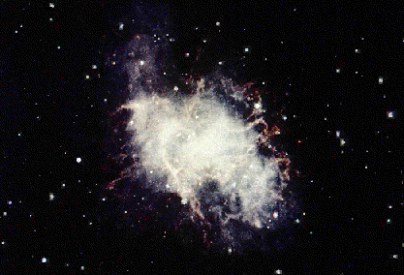
Other astronomy items
No population 3 stars – the kind of stars that evolutionary theory says should exist of only Helium, Hydrogen (and maybe Lithium?)
No old super nova remnants (oldest ones only thousands of years old, fits Biblical time scale, ex. Supernova that created Crab nebula, seen by Chinese in 1054 AD)
Uniform background radiation not only does not fit into Big Bang theory (horizon problem), in fact also indicates we are in the center
  Hubble himself admitted the universe looks like we are in the center
Companion galaxies with very different red shifts, contrary to big bang (see next slide)

Slide 21
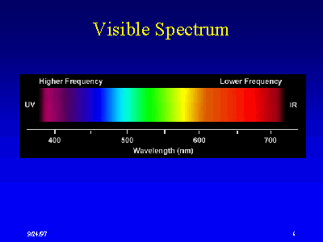
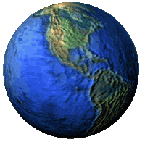
Redshift of Starlight
Light Spectrum
UV
Blue
Red
IR
Moving toward
Moving away
Used To:
Describe the expansion of the universe
The distance of a galaxy from the earth
So galaxies next to each other should not have different red shifts
Extracted from presentation by Mike Riddle www.Train2Equip.com
Compressed (blue side)
Stretched (red side)
Notes:
Used to describe the expansion of the universe. Most treatments compare redshifts of universe expansion to Doppler shifts
The redshift represents an expansion redshift not a Doppler shift (velocity).
They represent a shift in frequency – car horn
Using a combination of redshifts and Hubble’s law scientists calculate the distances of galaxies
But 17 times the Bible says the Lord stretched out the heavens. Could the red shift come from that??

Slide 22
Our perfect sun
Did you know that astronomers are hard pressed to find another star a suitable for life as our sun?
  Larger or smaller, cooler or hotter, all present problems for life on planets around them
  But even with the stars similar to our sun, none have been found to be as stable as the sun
    Flares and other fluctuations seen in similar stars are deadly for life around them
  Yet even as stable as our sun is, it is impossible for it to have been at just the right size and temperature for the billions of years that evolution demands for life to have started and developed on earth. (if 4.5 B years old it would have brightened by 40% over that time)

Slide 23
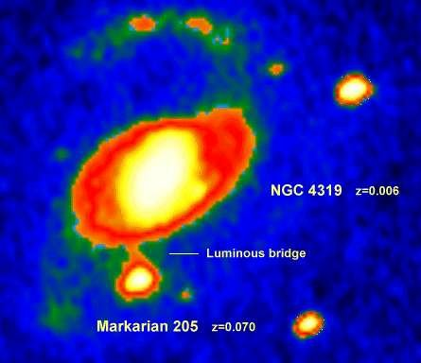
Other astronomy items
quasars tied in pairs to galaxies – showing cannot be ‘at edge’ of universe (again very different red shifts)
Big Bang predicts ‘monopoles’ (like a magnet with one pole) but none have ever been found.
Big Bang predicts there should be equal amount of matter and anti-matter. But (thankfully) there exists only traces of anti-matter
Strong evidence the moon is still geologically active

Slide 24
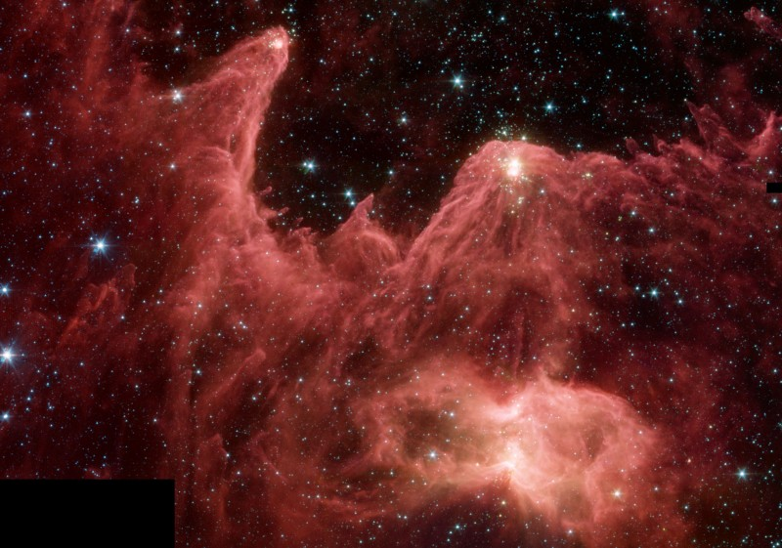
Star Formation and Physics
The popular theory is that stars form from vast clouds of gas and dust through gravitational contraction.
Star forming region?
Gas and dust clouds will expand NOT contract (violates Boyle’s gas law)
Nebula
Notes:
“Astronomers have yet to find an inter-stellar cloud in the actual process of collapse.” Fred Whipple, “the Mystery of Comets”, Smithsonian Inst. Press, 1985, p. 213.

Slide 25
One Alternate Theory
Speed of light changed with time?
Barry Setterfield cataloged all measurements made since the 1700’s showing the speed appearing to be asymptotically slowing down
Extrapolate back to the creation shows speed of light could be high enough for light from most distant objects in universe to reach earth in short time
Hotly contested even among creationists, not conclusively settled for either side. But in any case, has been a great stimulus for Creation Astronomy.

Slide 26
Another Biblically Based Theory
White Hole Theory : Black hole theory also predicts possibility for the opposite.
If God created the universe using a white hole with earth near the center, billions of years could elapse in rest of universe while only 6 days occurred on earth.
First proposed by D Russell Humphreys
  Shows much promise
Several other theories also proposed by creation astronomers
Matter expanding outward
earth
Event horizon (time stands still)
Earth passes through horizon late in creation sequence
Billions of years pass for matter outside horizon while one day passes on earth (day 4)

Slide 27
Summary
Bible has many references to the heavens revealing scientific information
Many evidences age of the universe fits within the Biblical framework
Big Bang theory has many holes
Promising alternate theories which show how vast distances can fit within Biblical time line.

Slide 28
References
“Answers magazine”: Vol. 3, # 1, Jan-Mar 2008.
Starlight and Time, D. Russell Humphreys, Master Books, 1994
D. Russell Humphreys, Ph.D., “Beyond Neptune: Voyager II Supports Creation”, http://www.icr.org/article/329/
D. Russell Humphreys, Ph.D., “Evidence for a Young World”, http://www.icr.org/article/1842/
Speed of light – Barry Setterfield, “The Atomic Constants, Light, and Time”, http://ldolphin.org/setterfield/index.html
Quasars -Halton Arp, http://www.haltonarp.com/
Hubble telescope and other images http://heritage.stsci.edu/ and http://antwrp.gsfc.nasa.gov/apod/
Mike Riddle, “Astronomy and the Bible” (and other PowerPoint presentations for download), https://www.creationtraining.org/media/downloads/
Donald B. DeYoung, Ph.D, Design in Nature: “The Anthropic Principle”, http://www.icr.org/article/253/
Vardiman and Humphreys, “A New Creationist Cosmology” https://www.icr.org/article/5870

Slide 29
For next lesson

Slide 30
What is the Anthropic Principle?
That everything about the universe tends toward making life on earth possible and sustaining it.
Proton mass: if it’s mass was just 0.2% greater, it would be unstable. The elements as we know them wouldn’t exist
gravity force is inversely proportional to the square of a separation distance, r. Anything other than exactly a factor of 2 would make stable orbits impossible
Sun’s mass
  if greater: luminosity output from the star would not be sufficiently stable
  if less: range of distances appropriate for life would be too narrow; tidal forces would disrupt the rotational period for a planet of the right distance
Sun’s color
  if redder or bluer: insufficient photosynthetic response

Slide 31
More anthropic examples
Earth’s gravity
  if stronger: planet's atmosphere would retain huge amounts of ammonia and methane
  if weaker: planet's atmosphere would lose too much water
distance from sun
  if farther away: too cool for a stable water cycle
  if closer: too warm for a stable water cycle
Lunar distance (and size)
  Greater distance, too little tidal activity, oceans become stagnant/support less life
  Less distance tidal forces too great and destructive

