Slide 1
Unlocking the Mysteries of Genesis*: Part 1
(*DVD series by The Institute for Creation Research (ICR))
Mark Jurkovich
Centerville Community Church
March 2019
Notes:
Before beginning this series I would like to lay some groundwork by addressing the question, “What type of book is the Bible?” (class of literature)

Slide 2
Does the Bible claim to be the Word of God?
2 Timothy 3:16 All scripture is given by inspiration of God, and is profitable for doctrine, for reproof, for correction, for instruction in righteousness,
2 Pet 1:21 For prophecy never had its origin in the will of man, but men spoke from God as they were carried along by the Holy Spirit.
Numbers 23:19 God is not a man, that he should lie, nor a son of man, that he should change his mind. Does he speak and then not act? Does he promise and not fulfill?
Proverbs 30:5-6 "Every word of God is flawless; he is a shield to those who take refuge in him. Do not add to his words, or he will rebuke you and prove you a liar.
Psalm 19: 7 The law (Torah) of the Lord is perfect, converting the soul
Bible verses will be either NIV or KJV unless noted
Notes:
(old notes: The Bible, though not a science book, does on occasion touch on things of a scientific nature. Whenever it does, contrary to secular beliefs, time and again shows itself to be scientifically accurate. It is not only spiritually true, and historically true, it is true in every other subject it touches on, including the sciences.)

Slide 3
Bible Verses (con.)
Heb 10:23 Let us hold unswervingly to the hope we profess, for he who promised is faithful.
2 Corinthians 1:20 For no matter how many promises God has made, they are "Yes" in Christ. And so through him the "Amen" is spoken by us to the glory of God.
Romans 15:4 For everything that was written in the past was written to teach us, so that through endurance and the encouragement of the Scriptures we might have hope.
Hebrews 4:12 For the word of God is quick, and powerful, and sharper than any two-edged sword, piercing even to the dividing asunder of soul and spirit, and of the joints and marrow, and is a discerner of the thoughts and intents of the heart.
Notes:
What credentials does the Bible have to back up the claim?
Claiming to be the WOG puts it into a higher category all by itself
So should be expected to stand up to higher scrutiny
But if it does stand up to it, we had better take what it says seriously

Slide 4
Fiction or Non-fiction?
First, can we even be sure that what we have today is what the authors originally wrote?
Ex. Islam teaches the Bible has been corrupted over the years (deliberately even)
Liberal theologians the past couple hundred years have sought to discern “what Jesus really said” vs. what was attributed to Jesus years later.

Slide 5
Objection 1: wasn’t the New Testament written down 100 or more years after the events occurred?
Truth - Time span:
The N.T. was written within 70 years (most books within 30) years of the death of Christ (AD 30).
Evidence:
1. Early church fathers (Clement, Ignatius) were quoting many of the N.T. books by around AD 100. The books that were quoted had to be in circulation at that time.
2. There is no hint that the N.T. writers knew of the destruction of the temple (AD 70) as a fact that had already happened.
3. According to history, PAUL died in the AD mid-60’s. At the end of Acts he is still alive. Therefore, Acts and the books Paul wrote most likely were written by the mid-60s. Luke wrote the book of Luke before he wrote the sequel, Acts. So the book of Luke is even earlier.
Conclusion: There was not time for distortions to grow up around the life of Christ.
Notes:
This claim was common perhaps 100 years ago. But since then most critical scholars accept the earlier dates for writing of the NT books.

Slide 6
Objection 2: But we do not have the original writings. Couldn’t they have been corrupted or embellished with each new copy? (all copied one at a time by hand after all)
Truth - Time span, part 2
The time span (between the originals and the earliest existing copies) for most classical Greek works is about 1,000 years;
the time span for most books in the N.T. is around 90 years.
Again the time is too short for the NT to have been corrupted
Author/Work Time span
Aristotle 1,400 yrs.
Caesar (Gallic Wars) 950 yrs.
Odyssey 500 yrs.
Livy (hist. of Rome) 400 yrs.
New Testament 90 yrs.
Notes:
Livy - Roman historian, author of the authorized version of the history of the Roman republic (http://www.livius.org/li-ln/livy/livy.htm)
Caesar wrote accounts of his battles.

Slide 7
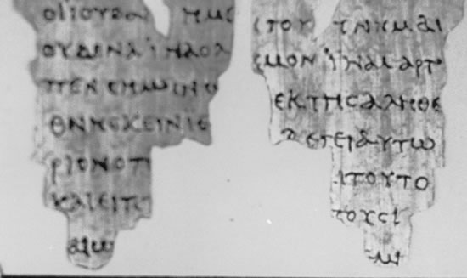
More on time span
Manuscripts have been found that date within or close to the first century:
One Example: John Ryland Papyrus (dated AD 125 ; fragment of John found in Egypt). The original manuscript must have been written earlier.

Slide 8
“Beans”
Click the following link to view video
https://arkencounter.com/bible-true/beans/

Slide 9
Objection 3: “Too few manuscripts?”
Truth - Number
The more manuscripts we have for comparison, the closer we can get to the original manuscript reading.
Plus tens of thousands of quotations from the N.T. by the early church fathers. It would be possible to construct the whole of the New Testament, apart from about eleven verses, from these writings alone.
5,700—Greek
10,000—Latin
9,300—other languages (ex. Syriac, Armenian, Ethiopic, Coptic, Gothic)
Notes:
Argument assumes lots of discrepancies between so many copies, so you cannot know which one is correct.

Slide 10
Comparison to numbers of other writings
Author/Work # of Copies
Plato 7
Caesar 10
Tacitus 20
Homer 643
New Testament 5,700 (Greek)
The quantity of manuscripts of classical Greek and Roman literature is very small. The piece of ancient literature (besides the Bible) with the greatest quantity of existing manuscripts is Homer’s Iliad (643 copies). The manuscript evidence for the N.T. is far superior to the manuscript evidence of classical Greek and Roman literature!
“The number of manuscripts of the N.T., or early translations from it in the oldest writers of the church, is so large that it is practically certain that the true reading of every doubtful passage is preserved in some one or other of these ancient authorities. This can be said of no other ancient book in the world” (Frederick Kenyon, renowned paleographer and textual critic).

Slide 11
Summary comparison
Author | Writings | Date Written | Earliest Copies | Time Gap | Number of Copies
Caesar | Gallic Wars | 100 – 44 B.C. | c. 900 A.D. | c. 1000 years | 10
Demosthenes |  | 384 - 321 B.C. | c. 1100 A.D. | c. 1400 years | 200
Josephus | The Jewish War | 37 – 100 A.D. | c. 900 A.D. | c. 800 years | 9
Homer | Iliad | 9th Century B.C. | c. 400 B.C. | c. 400 years | 1,700+
Herodotus | The Histories of Herodotus | 485 - 430 B.C. | c. 900 A.D. | c. 1300 years | 8
Livy | History of Rome | 64 B.C. – 17 A.D. | c. 300 A.D. (partial) c. 900 A.D. (mostly) | c. 300 years c. 900 years | 1 partial 19 copies
Plato | Dialogues | 428 – 347 B.C. | c. 900 A.D. | c. 1300 years | 7
Pliny the Elder | Natural History | 23 – 79 A.D. | c. 850 A.D. | c. 800 years | 7
Tacitus | Annals of Imperial Rome | 55 – 118 A.D. | c. 1100 A.D. | c. 1000 years | 20
Thycydides | History of the Peloponnesian War | 455 –400 B.C. | c. 900 A.D. | c. 1300 years | 8
The New Testament | Matthew to Revelation | 50 – 100 A.D. | c. 114 (fragments) c. 200 (books) c. 250 (most of N.T.) c. 325 (complete N.T.) | c. 50 years c. 100 years c. 150 years c. 225 years | 5664
Courtesy of - http://www.answers2prayer.org/bible_studies/new_testament/bibliographical.html
Notes:
Some newer numbers, https://answersingenesis.org/is-the-bible-true/is-the-bible-authoritative-and-inerrant/

Slide 12
Objection 4: there are so many discrepancies between the manuscripts that we still cannot know which is the original
Truth - Quality
The 643 copies of Homer’s Iliad are 95% pure which works out to be over 700 lines in question.
The 25,000+ N.T. manuscripts are 99.5% pure!
Ex. Romans 5:1 Paul says, "Therefore, since we are justified by faith we have peace with God through our Lord Jesus Christ." Some of the manuscripts have "we have peace with God." However, others have "let us have peace with God." In the Greek text it is merely the difference of one letter that changes the tense of the verb.
One thing is certain - no variant readings are significant enough to call in question any of its doctrines.
“The Christian can take the whole Bible in his hand and say without fear or hesitation that he holds in it the true Word of God, handed down without essential error* from generation to generation throughout the centuries” (Frederick Kenyon). [*missing actual word from original quote]
Notes:
Other side to the same argument. Assumption that there are lots of copying discrepancies.

Slide 13
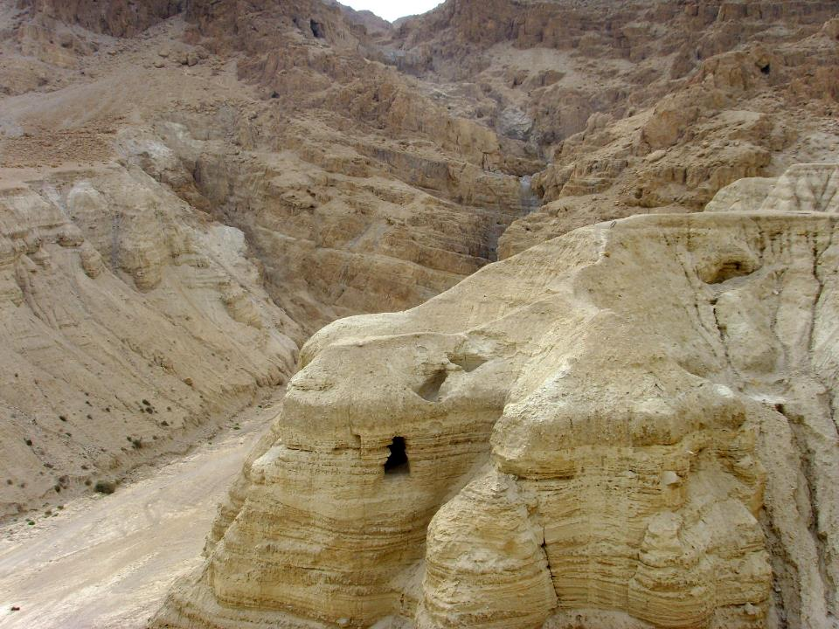
Old Testament Text
Jews working in the eighth and ninth centuries who were known as Masoretes, assembled the best Hebrew texts of the Old Testament available at the time and sought to preserve their purity. They gave us what is known as the Masoretic text.
1947 discovery of the Dead Sea Scrolls:
40,000 inscribed fragments recovered,
over 500 books have been identified.
About 100 of these are copies of the 39 books of the Old Testament. (Only Esther is not represented among them.)
Many of these writings pre-date the community. For example, a text of Exodus has been dated about 250 BC.
The RSV Bible “..proved to be word for word identical...in more than 95% of the text. The 5% variation consisted chiefly of obvious slips of the pen and variations in spelling.” (Gleason Archer, A Survey of the Old Testament)
Example Isaiah 53 – only one word different and it made no change to the sense of the passage.
Whole of Isaiah has only 13 minor changes between scrolls and the 1952 RSV Bible.
(Psalm 19)

Slide 14
Evidence the Bible is God’s Word

Slide 15
Word of God demonstrated by the fulfillment of prophesy
Prophecy Fulfillment by Jesus the Messiah
Tribe of Judah: Genesis 49:10 - Luke 3:23, 33
House of David: Jeremiah 23:5 - Luke 3:23, 31
Enter Jerusalem on a donkey: Zechariah 9:9 - Matt. 21:1–8
Born at Bethlehem: Micah 5:2 - Matt 2:1
Introduced by a messenger: Isaiah 40:3 - Matt. 3:1–3
Body pierced in crucifixion: Zechariah 12:10 - John 19:34
Laid to rest with the rich: Isaiah 53:9 - Matt. 27:57–60
Endure wounds and bruises: Isaiah 53:5 - Matt. 27:26
Teaching and healing ministry:
Isaiah 61:1, 2; 32:3–4; 35:5 - Matt. 9:35; Luke 4:17–21
Arrive before the Temple and Jerusalem destroyed:
Daniel 9:26 - Temple, Jerusalem destroyed AD 70
Labeled Lord and God: Jeremiah 23:6, Isaiah 9:6 - John 20:28, Luke 2:11
Killed 483 years after decree to rebuild Jerusalem:
Daniel 9:25–26 - Gospels, history (Christ died about AD 30)
Silent before accusers: Isaiah 53:7 - Matt. 27:12

Slide 16
What Is the Probability that Jesus Fulfilled Those Prophecies by Chance?
The odds of one man fulfilling just 7 of these prophesies was computed to be 1 in 10³⁸ !
Fulfilling 48 of them is an unfathomable 1 in 10¹⁵⁷!
There are ‘only’ 10⁸⁰ particles in the whole universe
Anything higher than 1 in 10⁵⁰ is considered mathematically impossible; i.e. a miracle, or the work of Almighty God
More complete list of messianic prophesies fulfilled in Jesus can be found at: http://christiananswers.net/dictionary/messianicprophecies.html

Slide 17
Summary
The Bible is by far the most well documented piece of literature of all writings from it’s time.
Written in first generation of Jesus’ resurrection
Oldest copies from within 100 years of writing
Many more manuscripts than any other writing of the era
Manuscripts 99.5% pure, no doctrines affected by variants
Shown as God’s word in the fulfilled messianic prophesies alone
66 books written by several dozen authors over about a 2000 year time span telling one consistent message of God’s redemption story for man.

Slide 18
Unlocking the Mysteries of Genesis
Topics to be covered from a Biblical perspective
Biology
Geology
Paleontology (dinosaurs)
Astronomy
Archaeology
Origins
Notes:
Now that we have established that we have in our hand what the authors intended, and that it indeed demonstrates that it is the Word of God
While not a history book, when the Bible touches on the sciences (and it does more than you would think), it reveals truth about that science.
This series will cover scientific truths contained in scripture

Slide 19
Unlocking the Mysteries of Genesis: Part 1
Design or Random Chance?
All life cries out “Fearfully and Wonderfully Made!” (Ps. 139:14)
Elephant’s trunk
Mimic octopus: mimics at least 15 other creatures
Beauty everywhere (only limited cases can be accounted for by ‘attracting a mate’)
Adaptation has severe limits
Evolution cannot explain origin of male and female
Not one undisputed transitional form

Slide 20
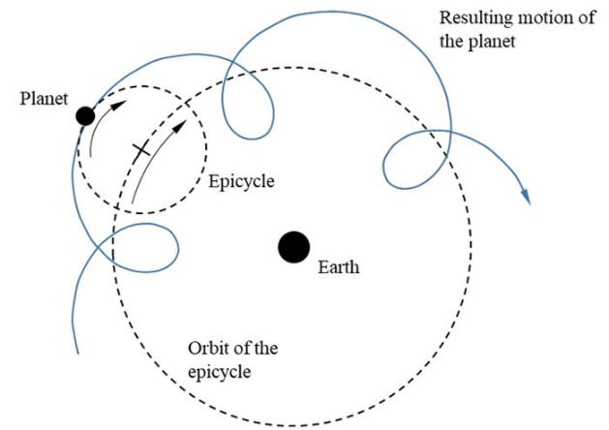
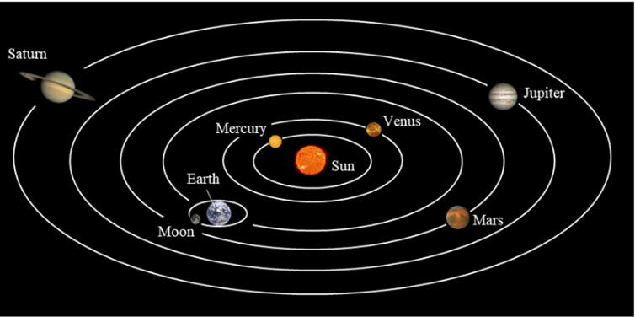
Occam’s Razor
“The explanation requiring the fewest assumptions is most likely to be correct”
Example: heliocentric versus geocentric
Copernicus’ heliocentric
Ptolemy’s geocentric
https://creation.com/galileo-church
Notes:
Geocentric based solar system
2nd example: existence of comets

Slide 21
Scripture in Session1
Romans 1:20 For since the creation of the world God’s invisible qualities—his eternal power and divine nature—have been clearly seen, being understood from what has been made, so that people are without excuse.
Genesis 1
Isaiah 14:24 The Lord Almighty has sworn, “Surely, as I have planned, so it will be, and as I have purposed, so it will happen.
Notes:
Intelligent design movement – wonderful job pointing out the general revelation of God (Rom 1:20)
But they stay away from the Special revelation of God. You need both to understand our God. Why you need the Word of God to know his special revelation.

Slide 22
Psalm 104:24 How many are your works, Lord! In wisdom you made them all; the earth is full of your creatures
Proverbs 3:19 By wisdom the Lord laid the earth’s foundations, by understanding he set the heavens in place;
Ephesians 2:10 For we are God’s handiwork, created in Christ Jesus to do good works, which God prepared in advance for us to do.

Slide 23
References
“The accuracy of modern New Testament translations.” https://bible.org/article/how-accurate-bible
“The Bible: An Extra Terrestrial Message”, Chuck Missler, Koinonia House, 1996
http://www.answers2prayer.org/bible_studies/new_testament/bibliographical.html
http://www.messianic-prophecy.net/Messianic-Prophecy.htm
Some more information on the Dead Sea Scrolls
https://www.deadseascrolls.org.il/
https://christiananswers.net/q-abr/abr-a023.html
https://probe.org/the-dead-sea-scrolls/
Background image courtesy of AIG: http://www.answersingenesis.org/Home/Area/overheads/TOC.asp

Slide 24
Veracity of the Biblical Text
Backup info
How we know that what we have today is what the authors wrote

Slide 25
The Bibliographical Test
The Bibliographical test evaluates the reliability of manuscripts,
looking at the time elapsed between original and existing manuscripts,
Time between events and when written down
Time between written down and oldest copies still existing
number of manuscripts,
and discrepancies (how much variation between the readings of the existing manuscripts).
This test determines how well a document has been preserved since it was written. This test will determine whether or not we have what was originally written.
Notes:
As in bibliography – references to back up the contents of the writing

